Slide 1
The Calling of Isaiah
Isaiah 6
Jean Louis Ernest Meissonier 1838

Slide 2
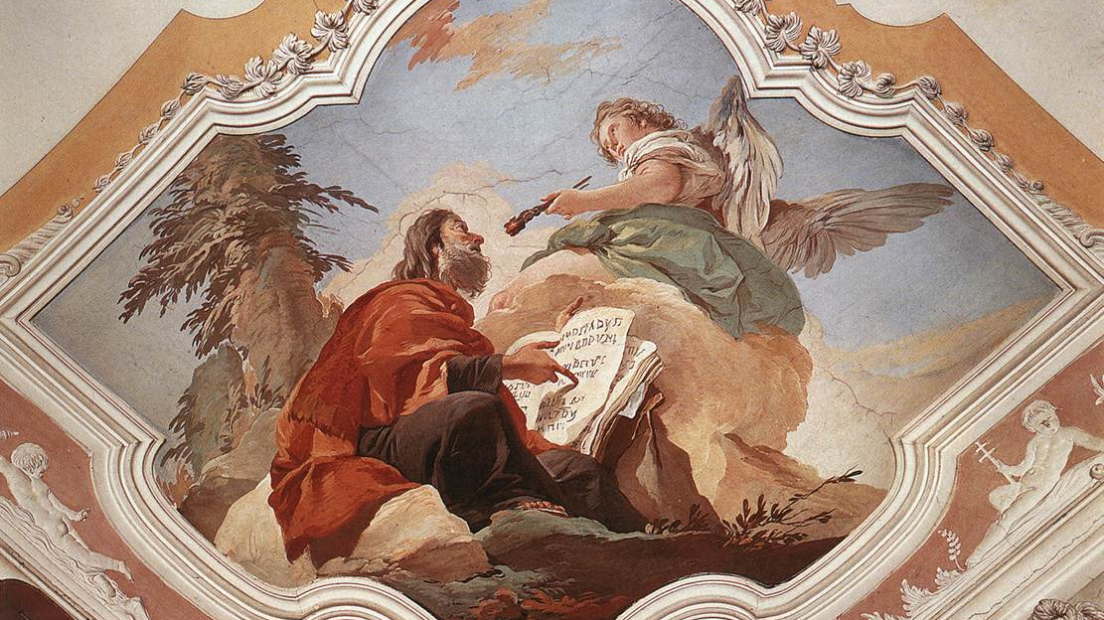
The Gospel According to Isaiah
Giovanni Battista Tiepolo ~ 1728

Slide 3
The Gospel According to Isaiah
“And let us run with perseverance the race marked out for us, fixing our eyes on Jesus, the pioneer and perfecter of faith. For the joy set before him he endured the cross, scorning its shame, and sat down at the right hand of the throne of God” – Hebrews 12:1-2
Giovanni Battista Tiepolo ~ 1728

Slide 4
The Gospel According to Isaiah
Whole Bible is about Jesus
See the Gospel in the Old Testament
Explains who Jesus is – Example to follow
Giovanni Battista Tiepolo ~ 1728

Slide 5
The Gospel According to Isaiah
~740 BC
Uzziah/Azariah dies – 2 Kings 15 / 2 Chr 26
Widespread idolatry in Judah – 2 Kings 15:4
Threat of invasion by Assyria – Isaiah 8
Isaiah bring message of exile and hope
Jean Louis Ernest Meissonier 1838

Slide 6
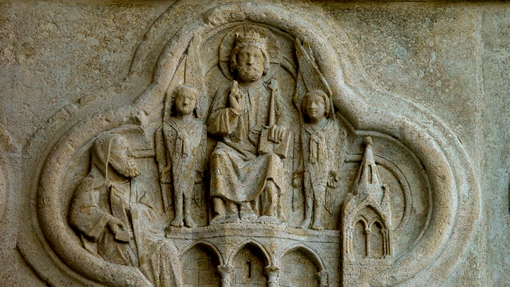
Isaiah’s Vision / Isaiah’s Calling
Amiens Cathedral ~1230

Slide 7
Isaiah’s Vision / Isaiah’s Calling
In the temple – God on His throne
God’s glory – God’s Holiness
Amiens Cathedral ~1230

Slide 8
Isaiah’s Vision / Isaiah’s Calling
Amiens Cathedral ~1230

Slide 9
Isaiah’s Vision / Isaiah’s Calling
Fearful holiness – Exposes sin – Makes us Holy
Fire consumes – Fire refines – Malachi 3:2-3
Isaiah’s sin – Personal and Communal
Cleansed by God’s grace through atonement – Lev. 16:12
Amiens Cathedral ~1230

Slide 10
Isaiah’s Vision / Isaiah’s Calling
Fearful holiness – Exposes sin – Makes us Holy
Fire consumes – Fire refines – Malachi 3:2-3
Isaiah’s sin – Personal and Communal
Cleansed by God’s grace through atonement – Lev. 16:12
Vision of Jesus – John 12:40-41 – God’s salvation plan
Jesus atones ‘once for all’ – Hebrew 7:27 – Rev. 5:6, 9-10
Amiens Cathedral ~1230

Slide 11
Isaiah’s Vision / Isaiah’s Calling
Amiens Cathedral ~1230

Slide 12
Isaiah’s Vision / Isaiah’s Calling
God’s revelation to Isaiah
God’s revelation through Isaiah
Isaiah called to tell about God’s judgement & salvation
Jesus revealed to us – John 12:45
Jesus revealed through us – John 17:18
Amiens Cathedral ~1230

Slide 13
“Here I Am. Send Me”
Jean Louis Ernest Meissonier 1838

Slide 14
“Here I Am. Send Me”
Isaiah’s call to repentance falls on deaf ears – Isaiah 6:9-10
Hebrew idiom: The Result ≠ The Aim
Judgement leads to exile – Isaiah 6:11-13
Some still listen, repent and obey – Isaiah 6:13
Jean Louis Ernest Meissonier 1838

Slide 15
“Here I Am. Send Me”
Isaiah’s call to repentance falls on deaf ears – Isaiah 6:9-10
Hebrew idiom: The Result ≠ The Aim
Judgement leads to exile – Isaiah 6:11-13
Some still listen, repent and obey – Isaiah 6:13
Jesus received the same way – Matthew 13
Pray for revelation – Acts 9
Jean Louis Ernest Meissonier 1838

Slide 16
The God Who Reveals Himself
Amiens Cathedral ~1230

Slide 17
The God Who Reveals Himself
We stray – God still reveals
We sin – Jesus atones
We reject – God reaches out
God still purifies people and sends them to proclaim
Amiens Cathedral ~1230

Slide 18
The God Who Reveals Himself
We stray – God still reveals
We sin – Jesus atones
We reject – God reaches out
God still purifies people and sends them to proclaim
“Here we are. Send us”
Amiens Cathedral ~1230

