Slide 1
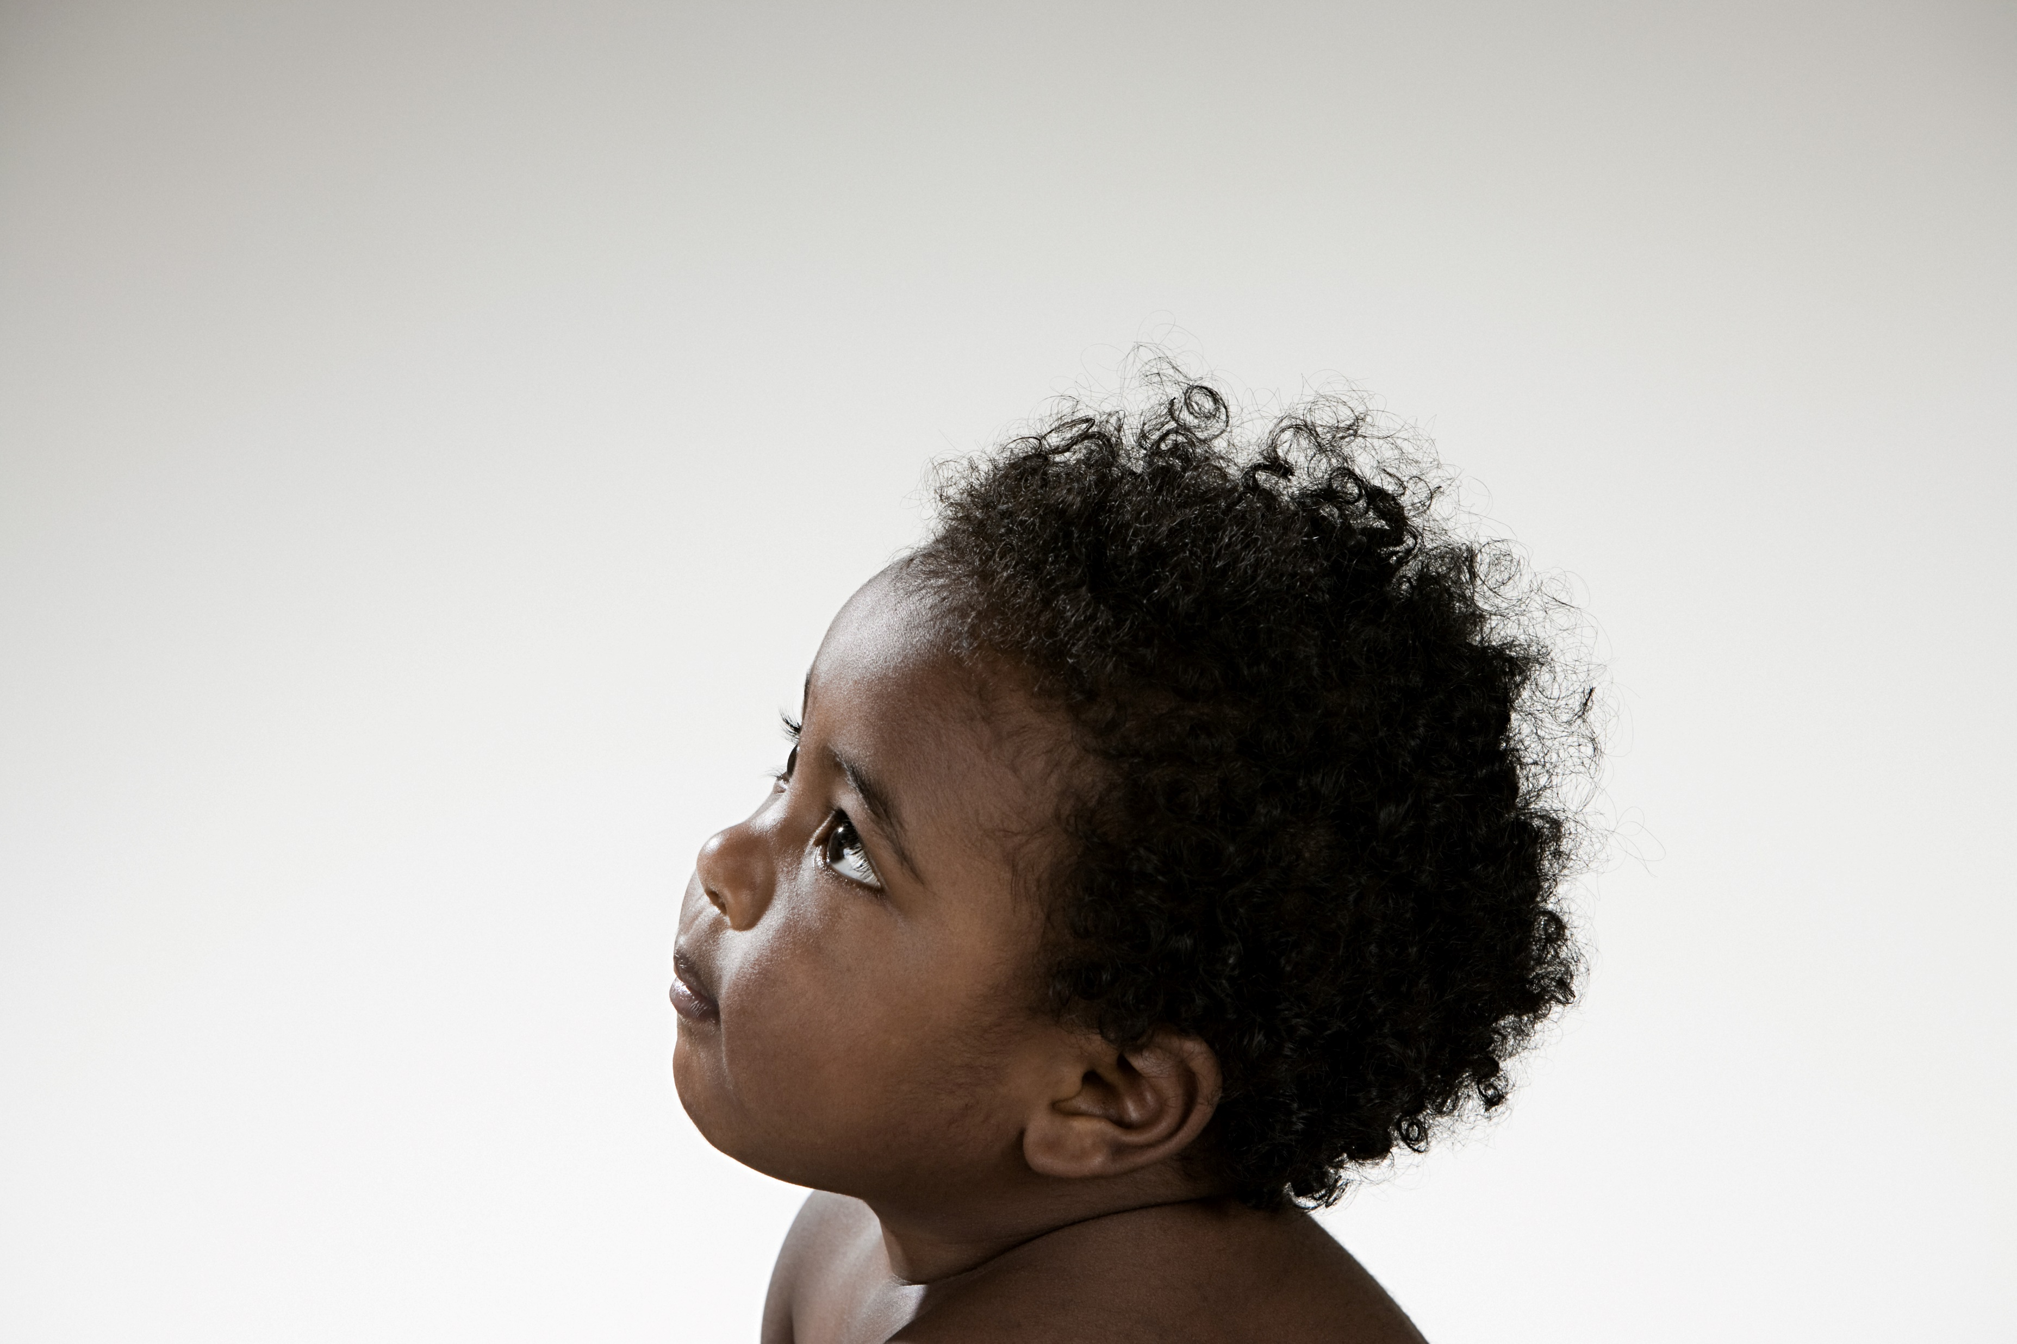
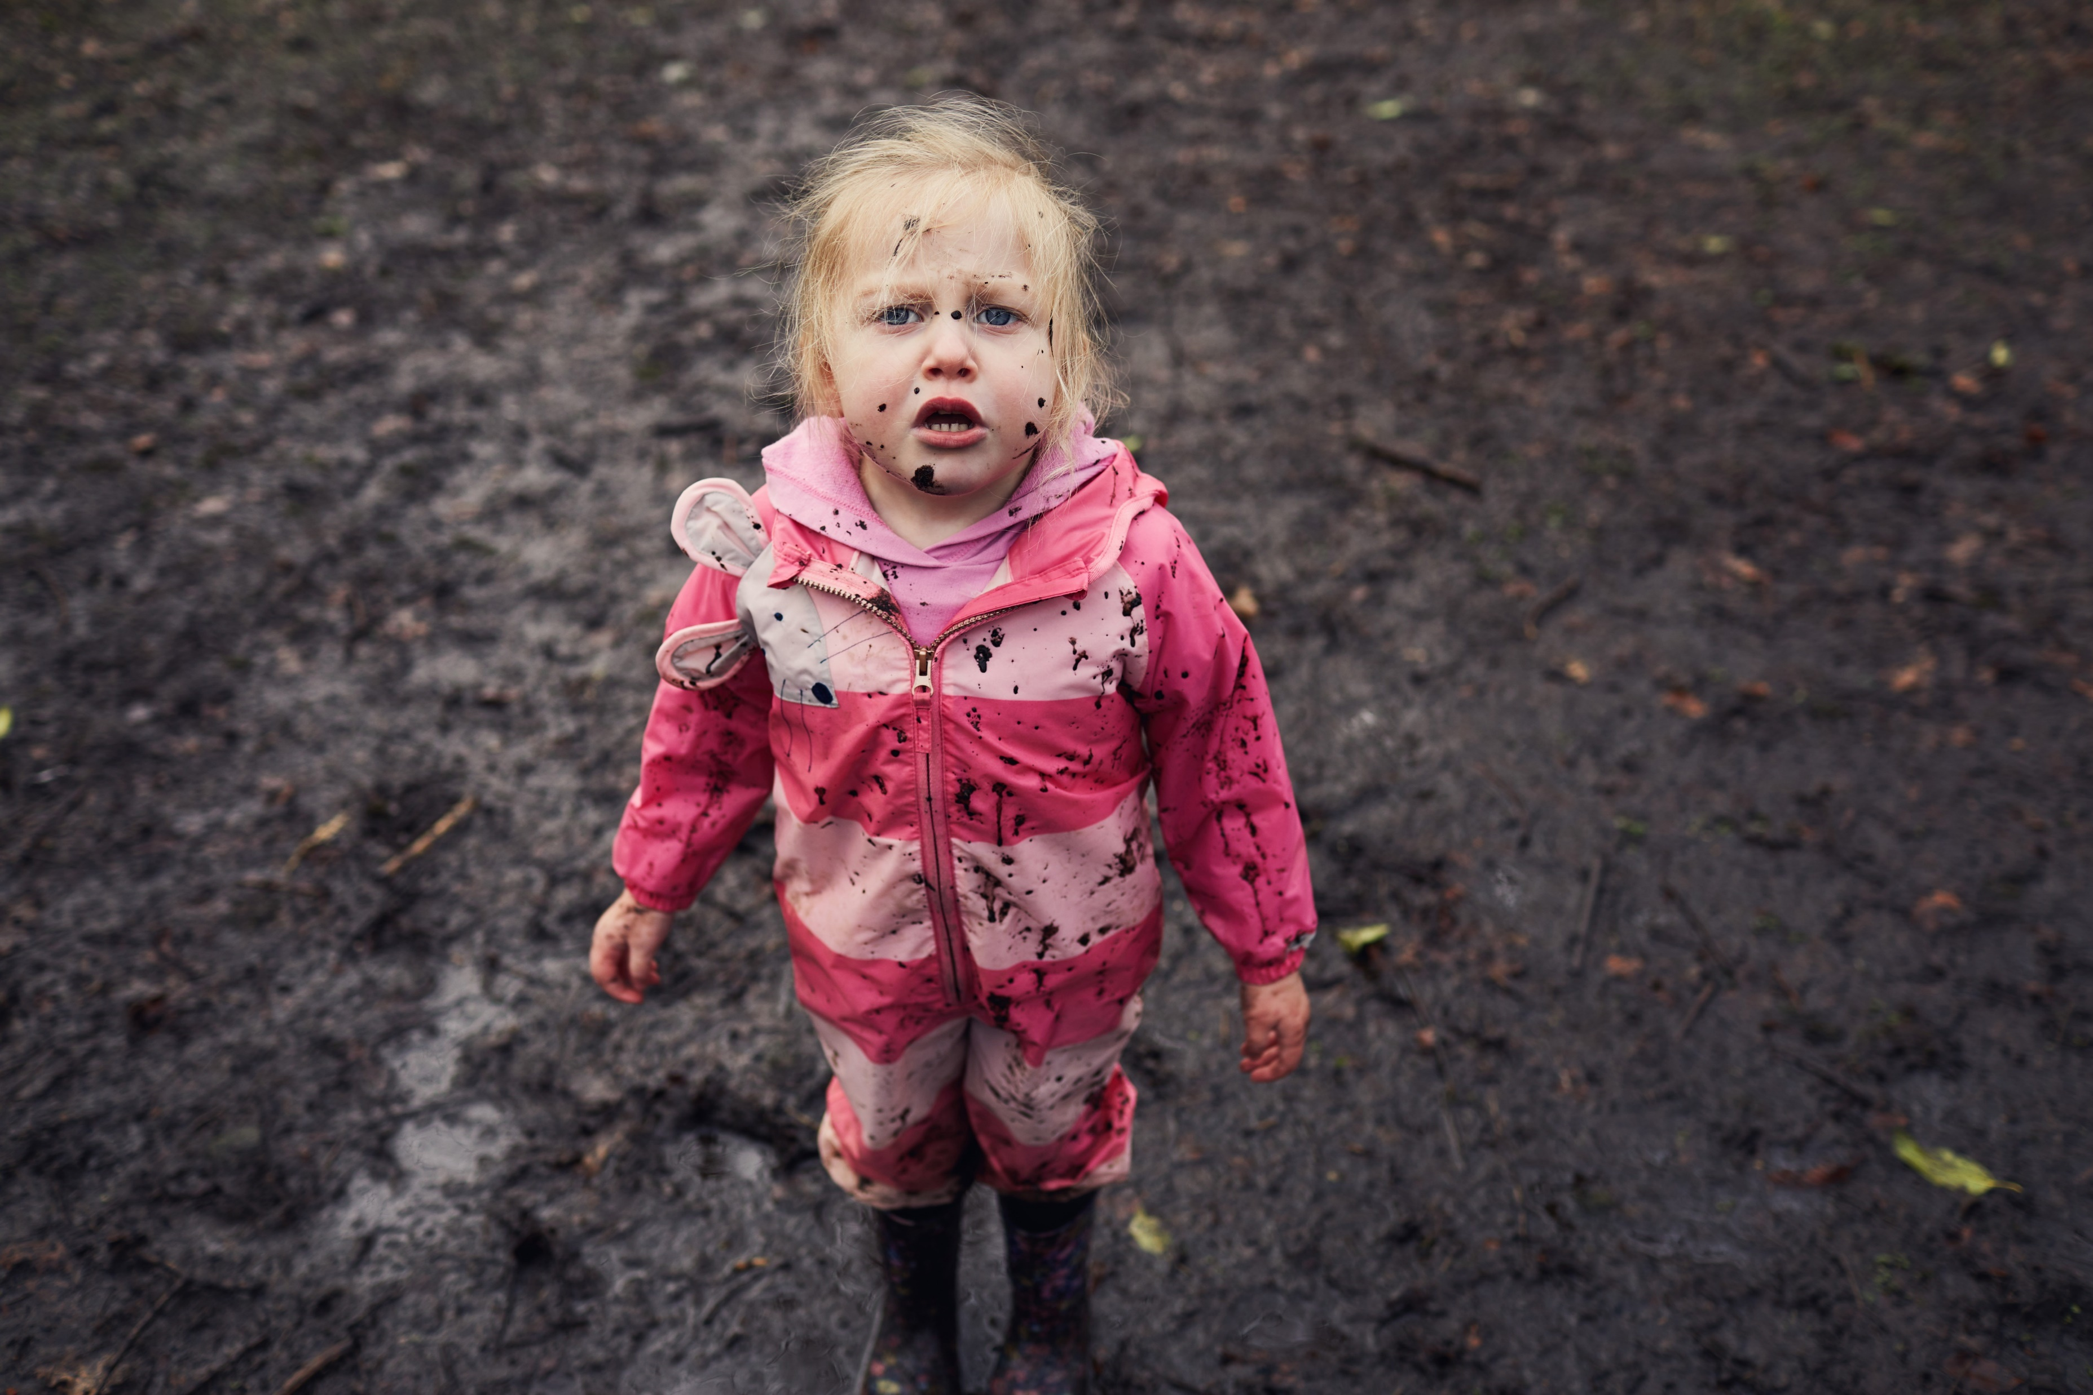
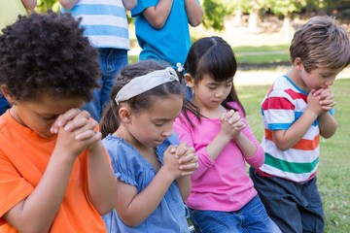
Faith Like Little Children

Slide 2
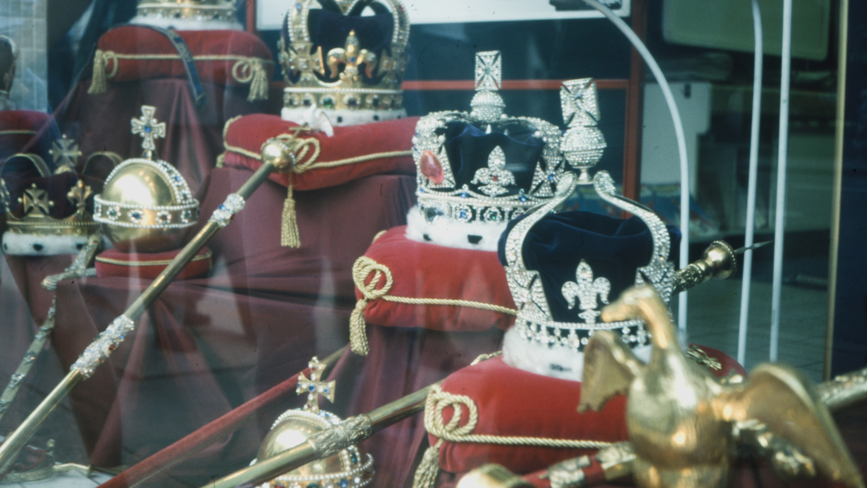
King Charles: Visit to Leeds

Slide 3
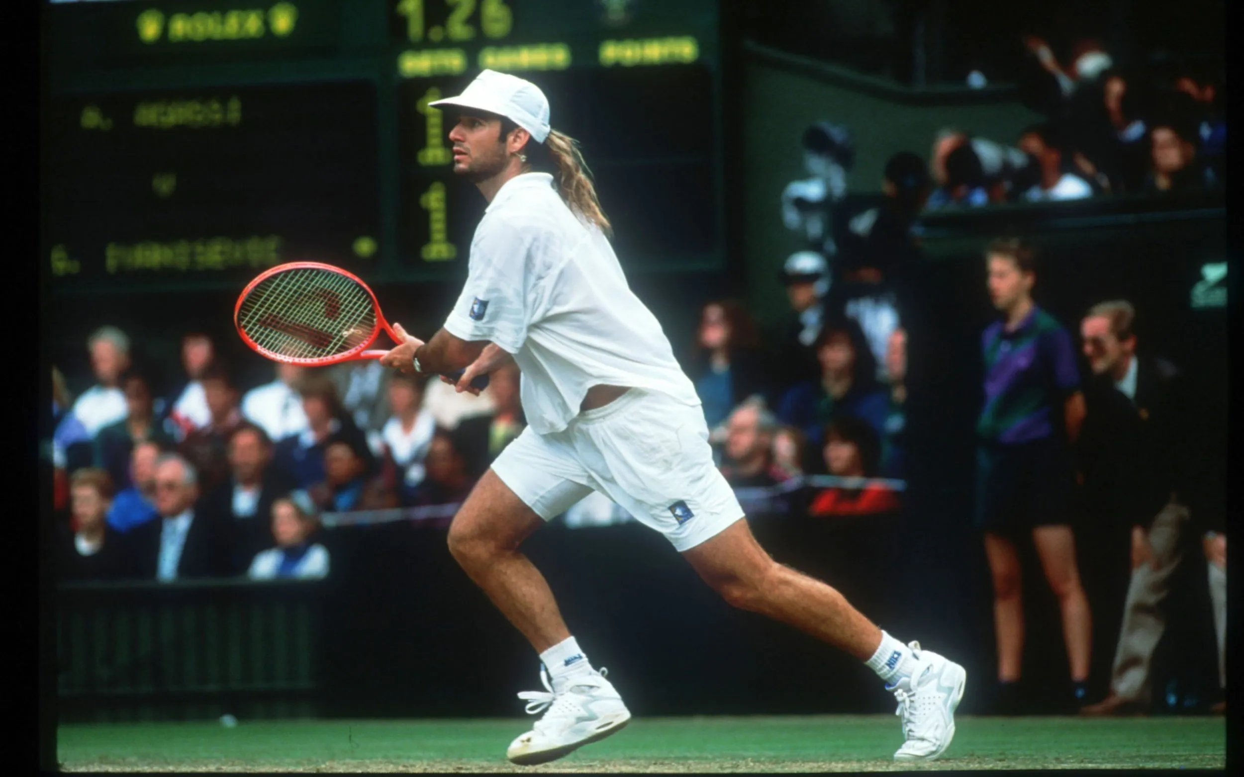
Agassi: 1992

Slide 4
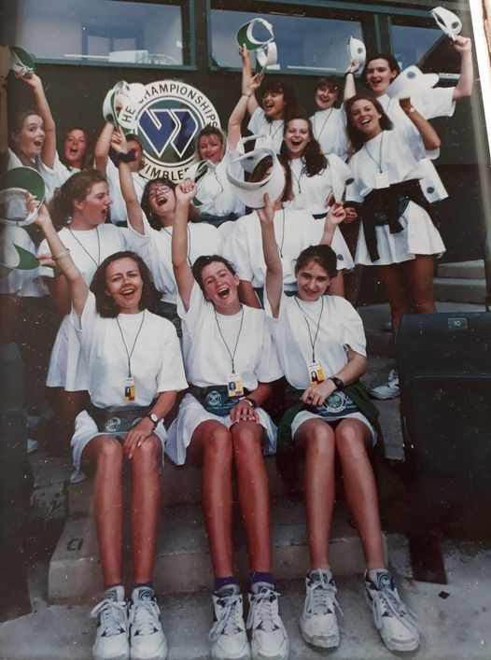
Guide/Litter Picker
Wimbledon 1992

Slide 5
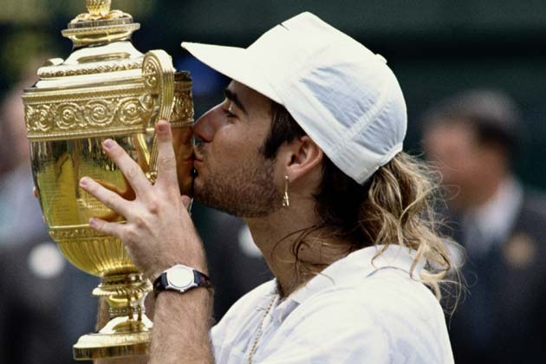
Agassi wins Wimbledon, 1992

Slide 6
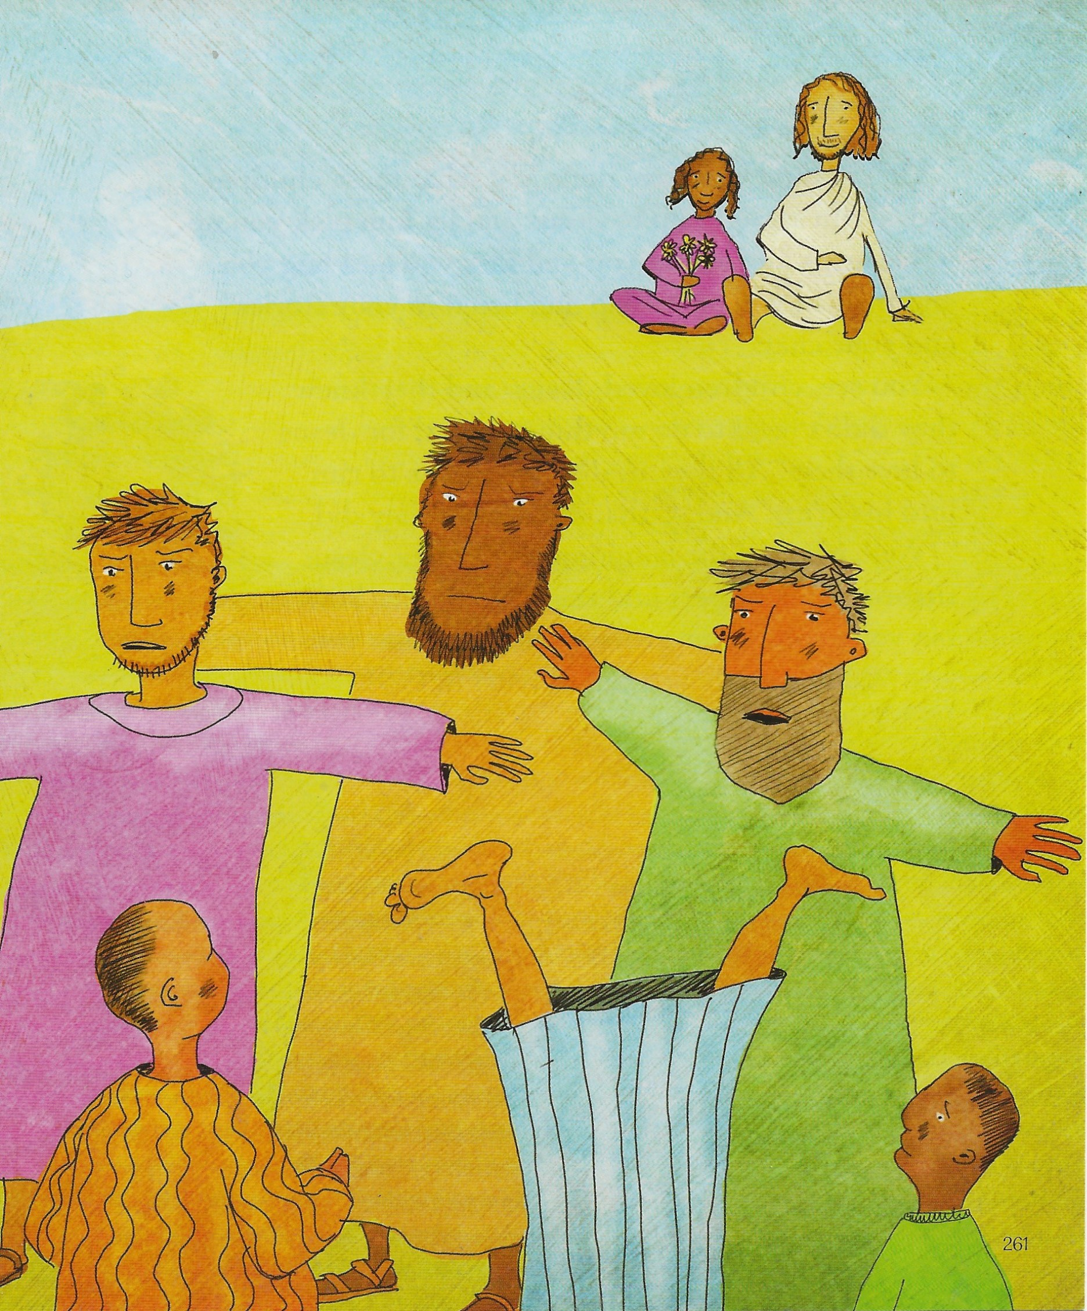
The Gatekeepers
People were also bringing babies to Jesus for him to place his hands on them. When the disciples saw this, they rebuked them.
Luke 18 v 15

Slide 7
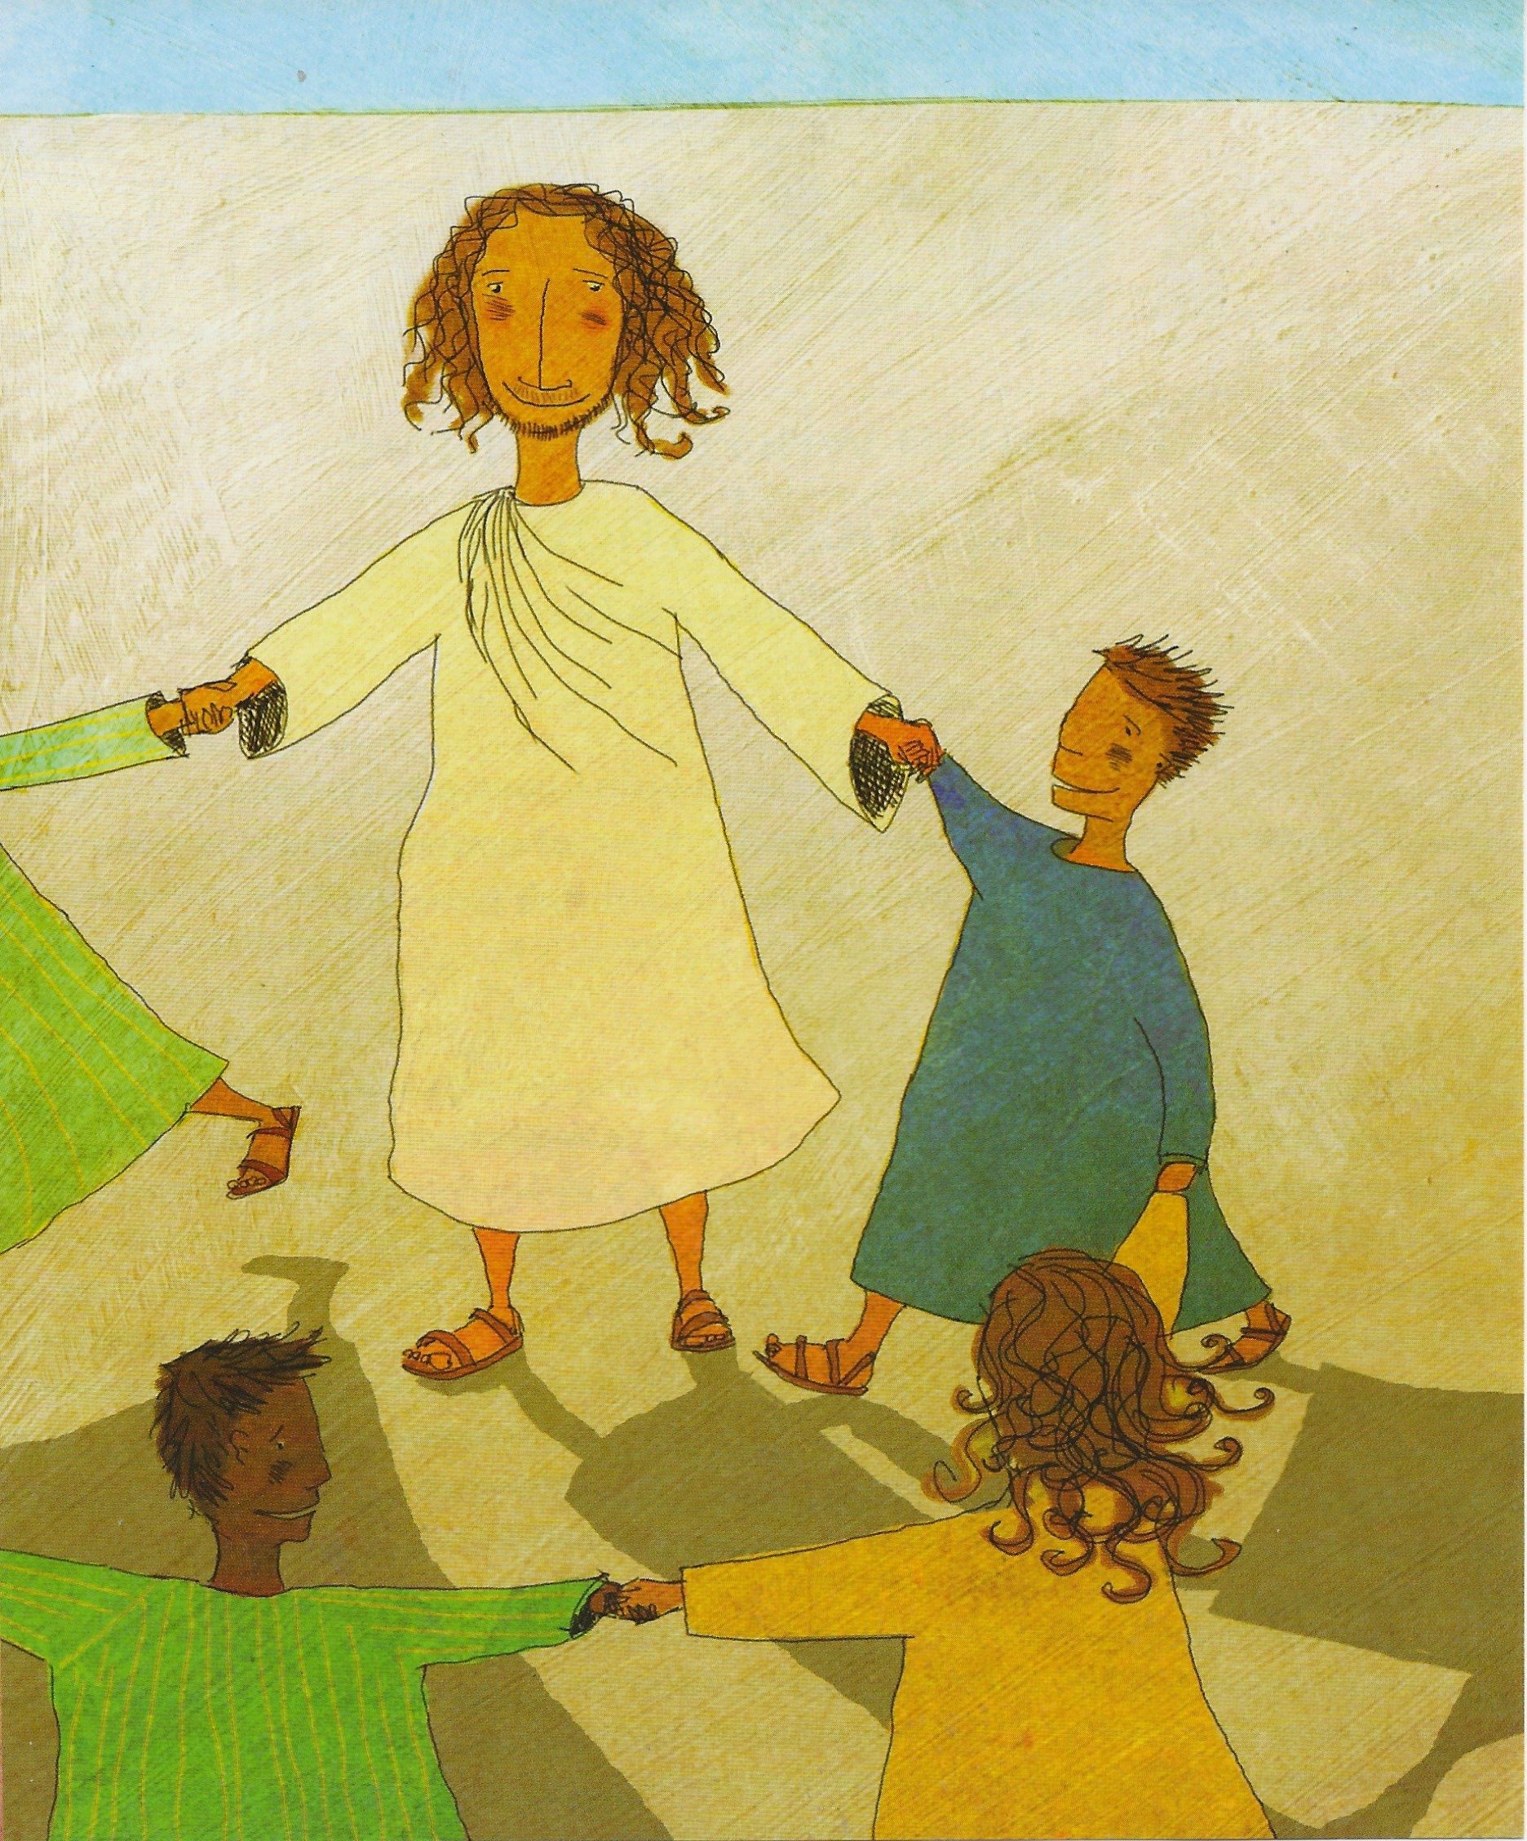
Let the little children come to me
¹⁶ But Jesus called the children to him and said, “Let the little children come to me, and do not hinder them, for the kingdom of God belongs to such as these. ¹⁷ Truly I tell you, anyone who will not receive the kingdom of God like a little child will never enter it.”
Luke 18 v 16-17

Slide 8
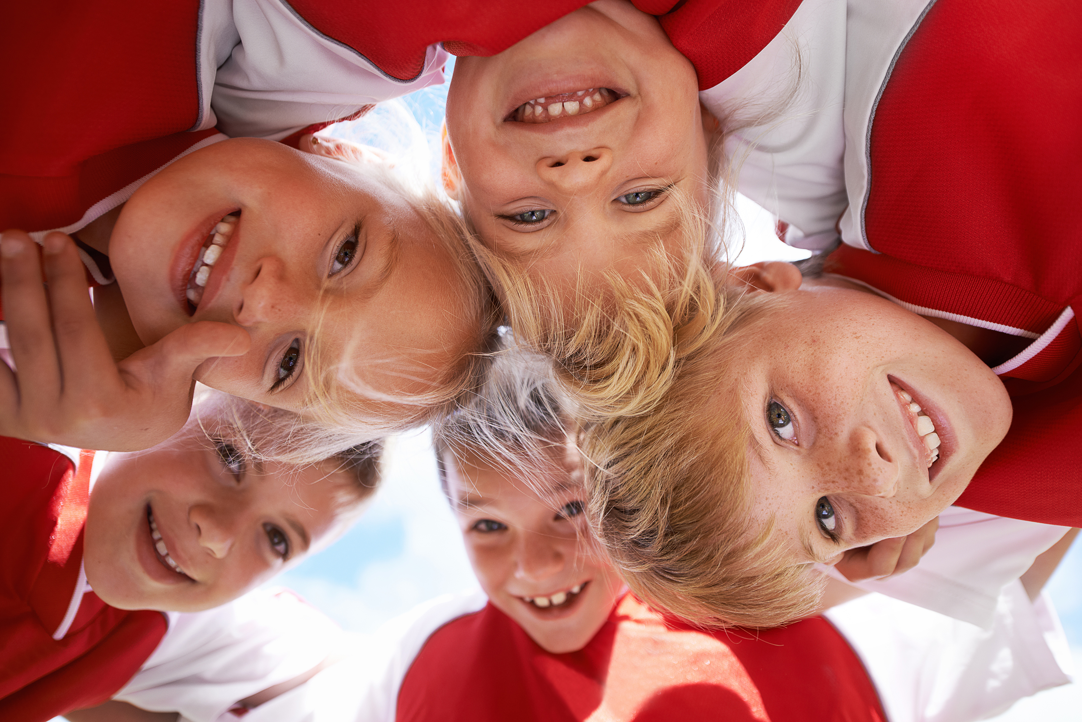
Precious

Slide 9
How can we have faith like little children?

Slide 10
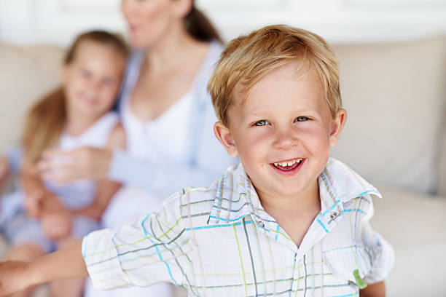
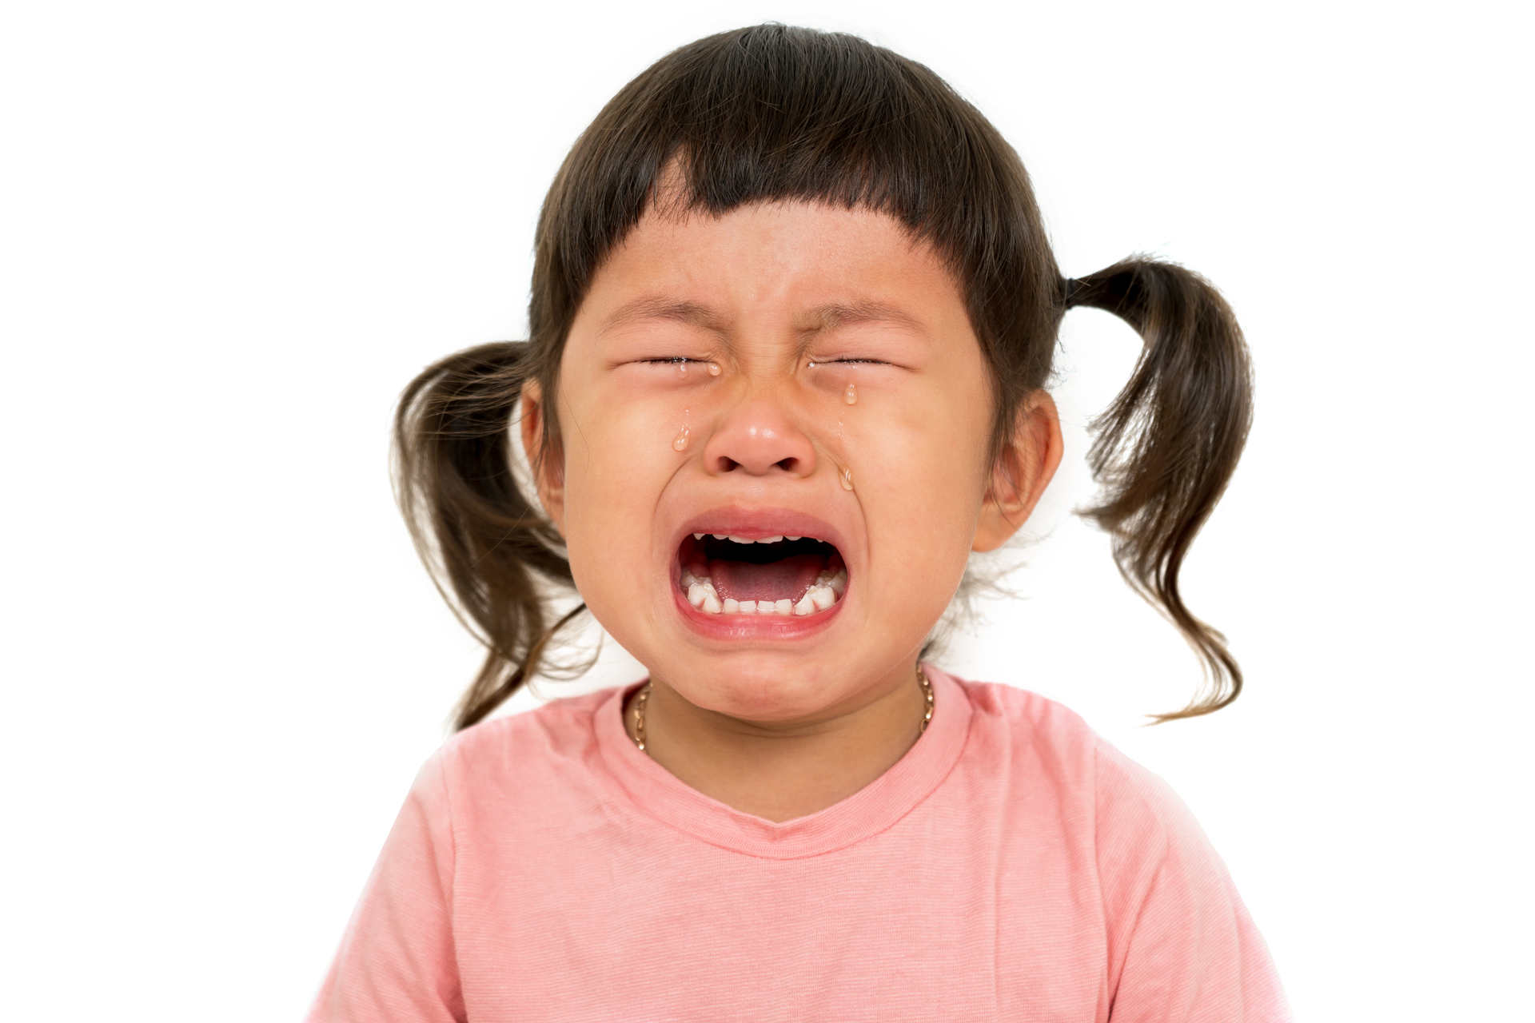
Honesty

Slide 11
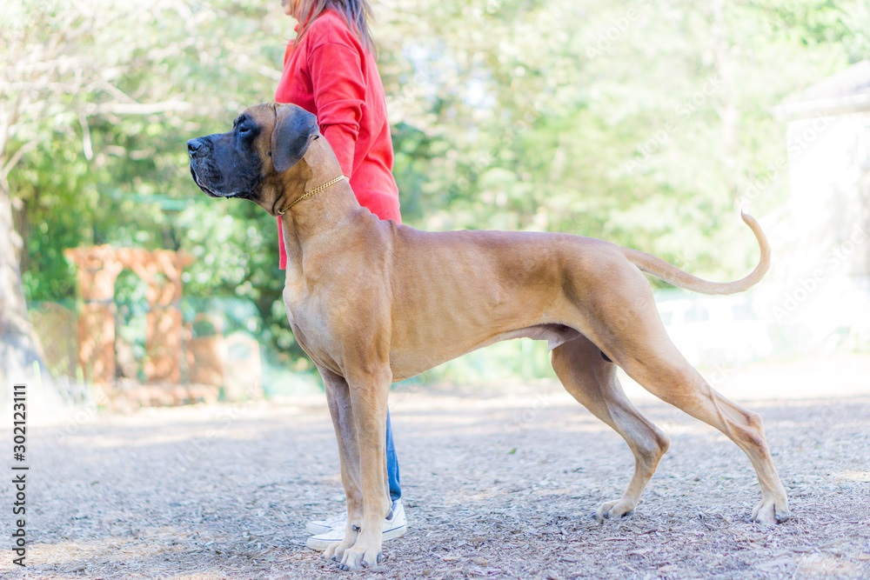
Tell it like it is!

Slide 12
Tell it like it is!
Open your heart honestly to God in prayer

Slide 13
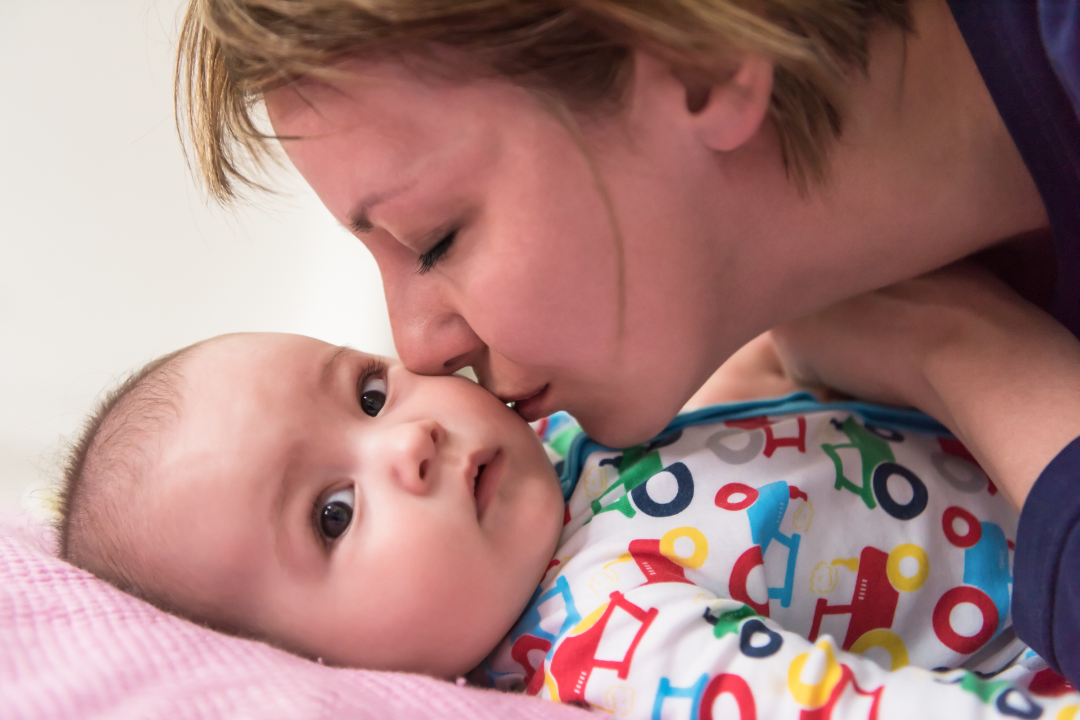
Trust

Slide 14
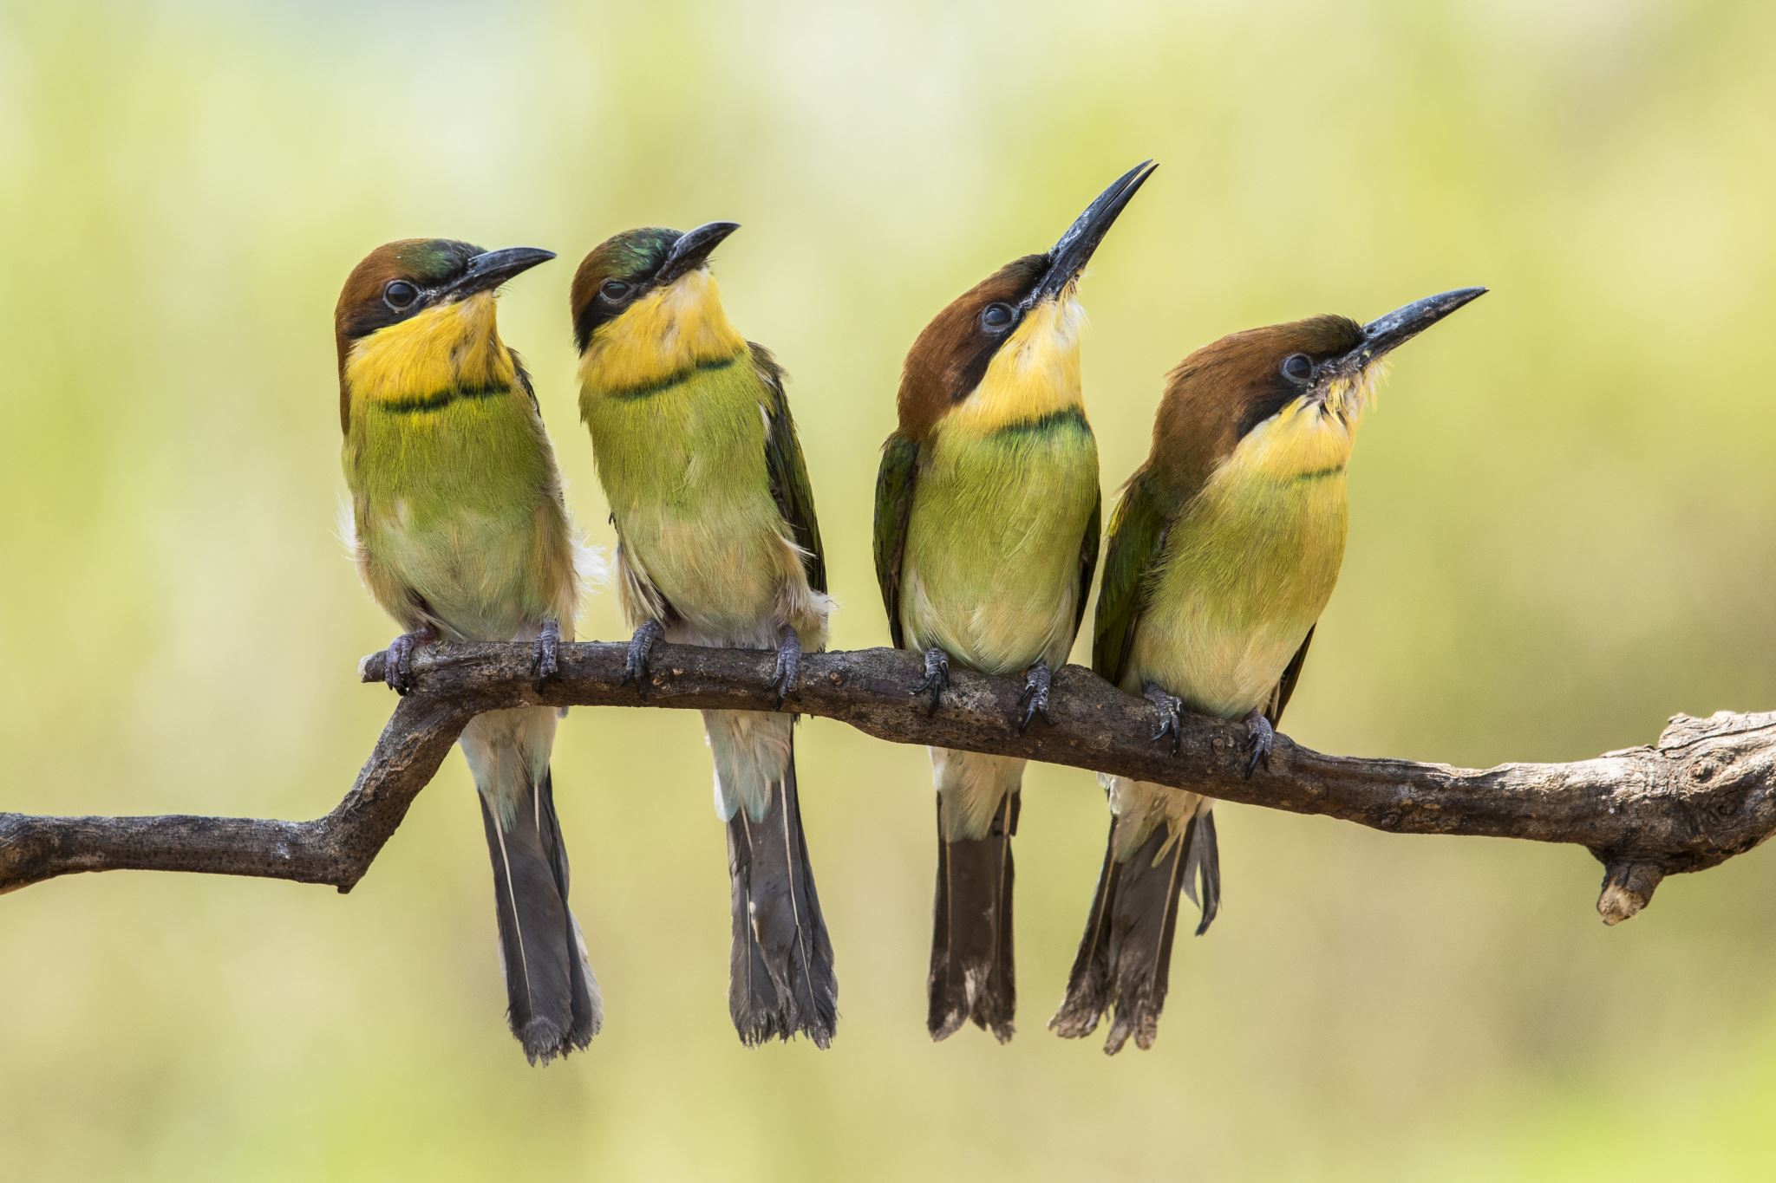
God Provides!
²⁵ Therefore I tell you, do not worry about your life, what you will eat or drink; or about your body, what you will wear. Is not life more than food, and the body more than clothes? ²⁶ Look at the birds of the air; they do not sow or reap or store away in barns, and yet your heavenly Father feeds them. Are you not much more valuable than they? ²⁷ Can any one of you by worrying add a single hour to your life?
Matthew 6 v 25-27

Slide 15
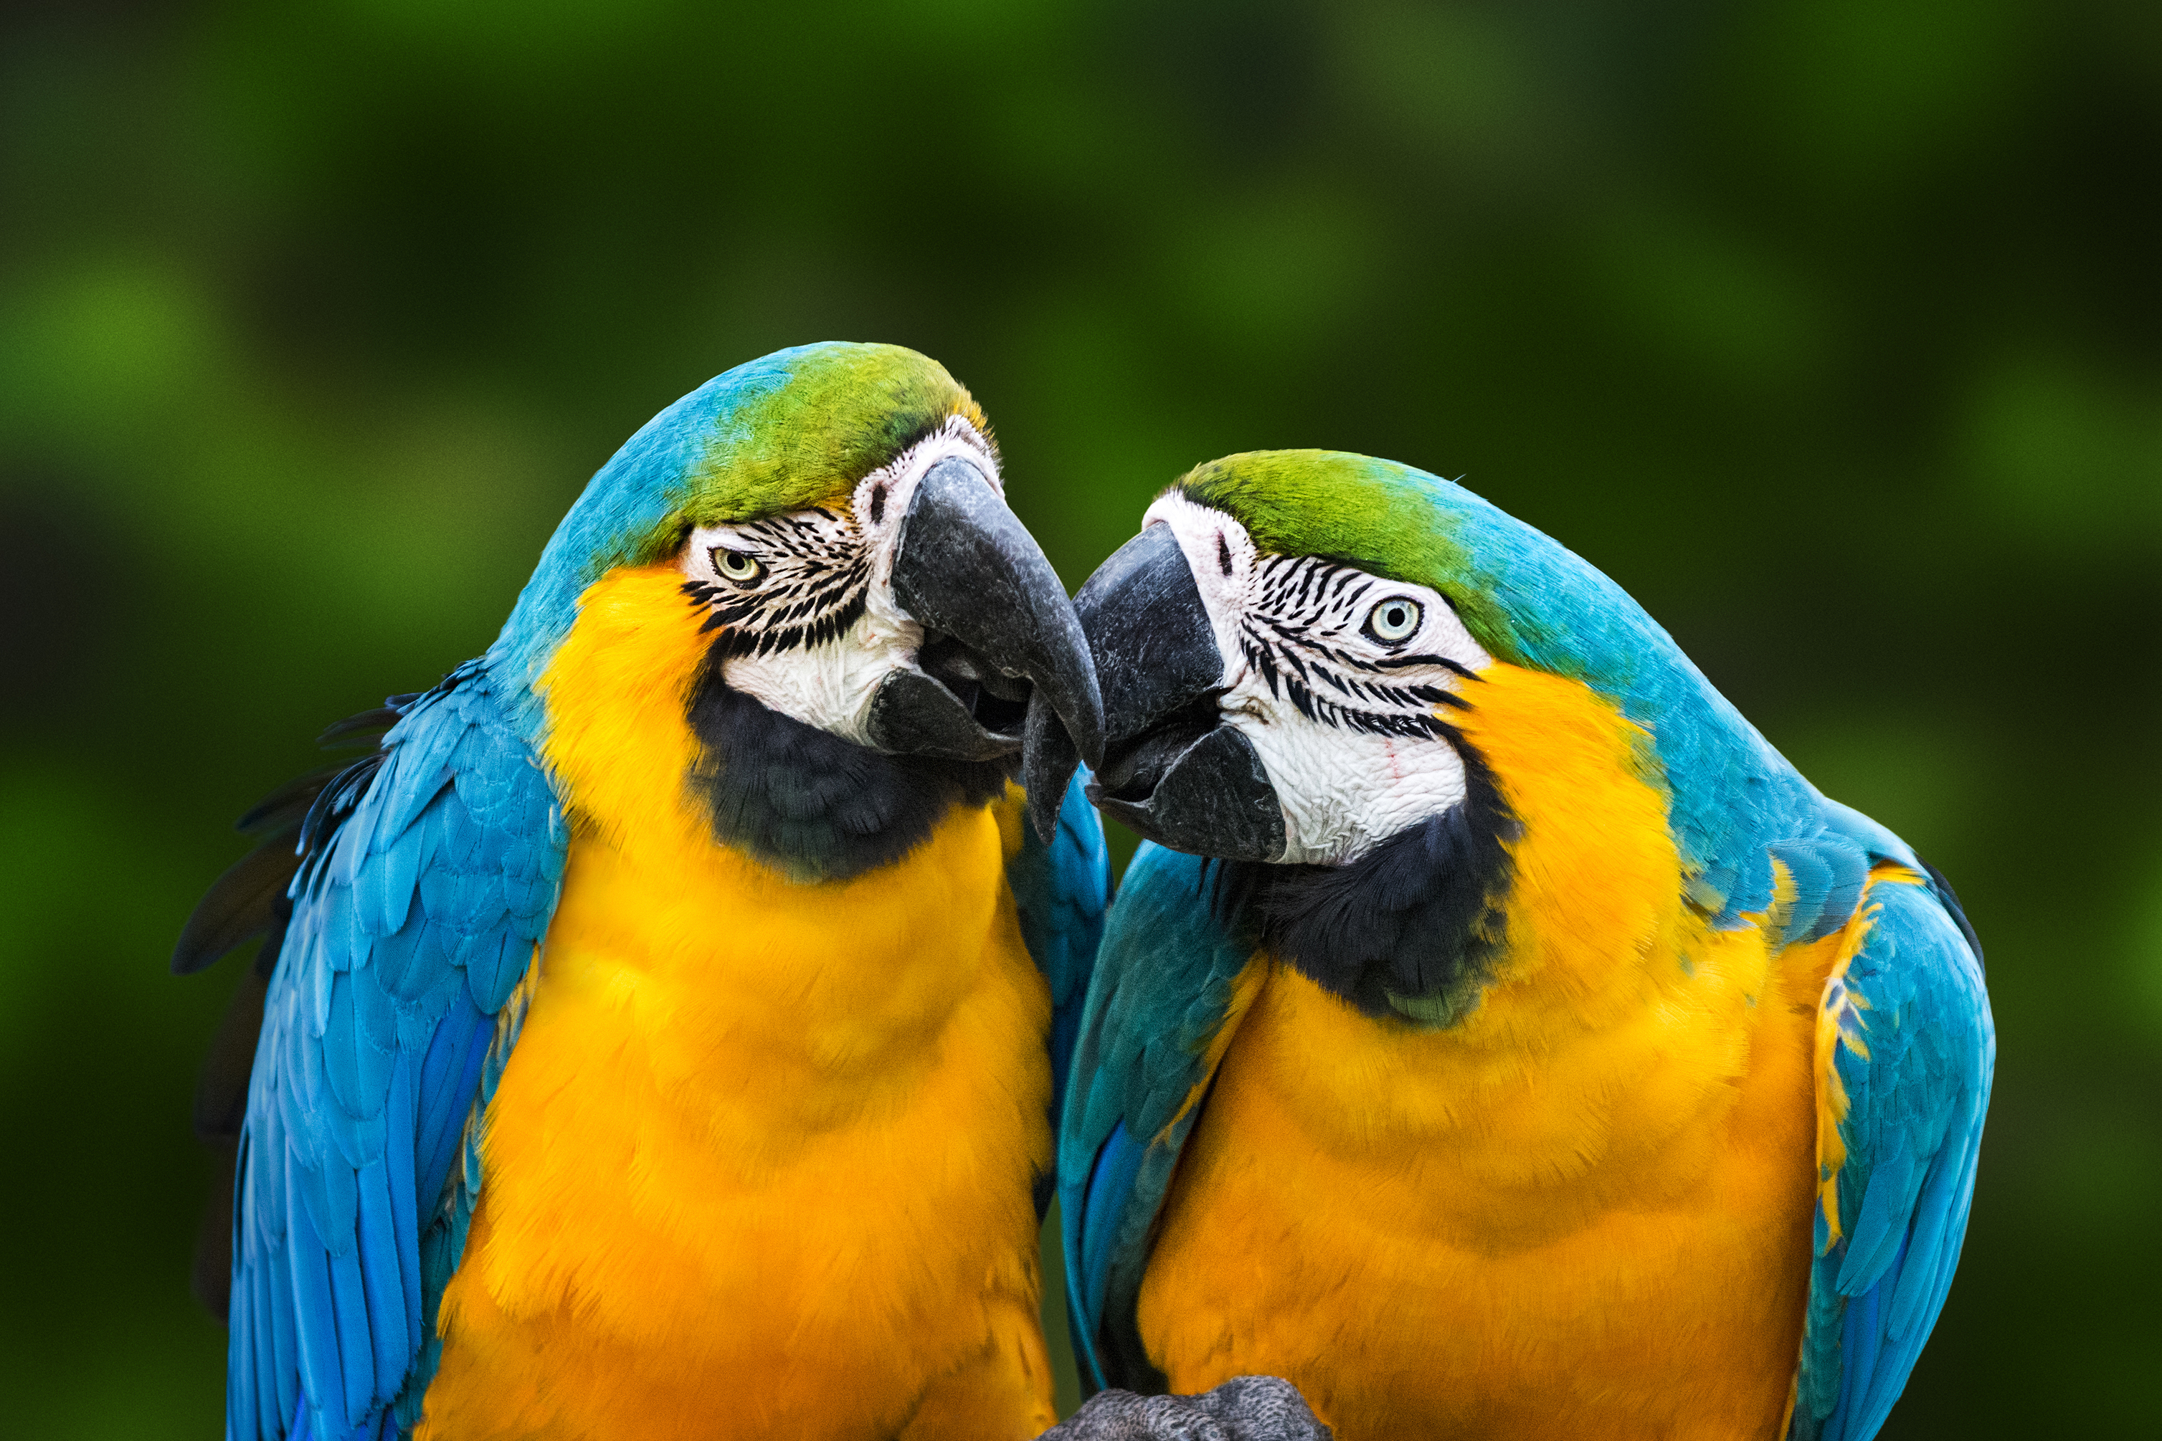
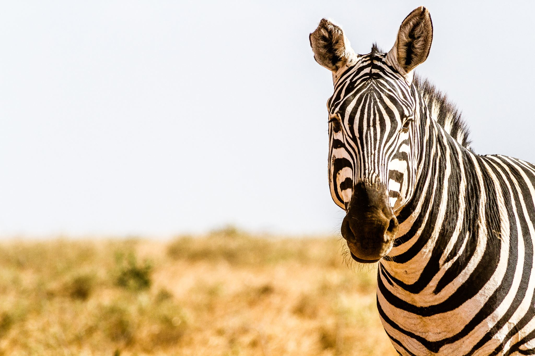
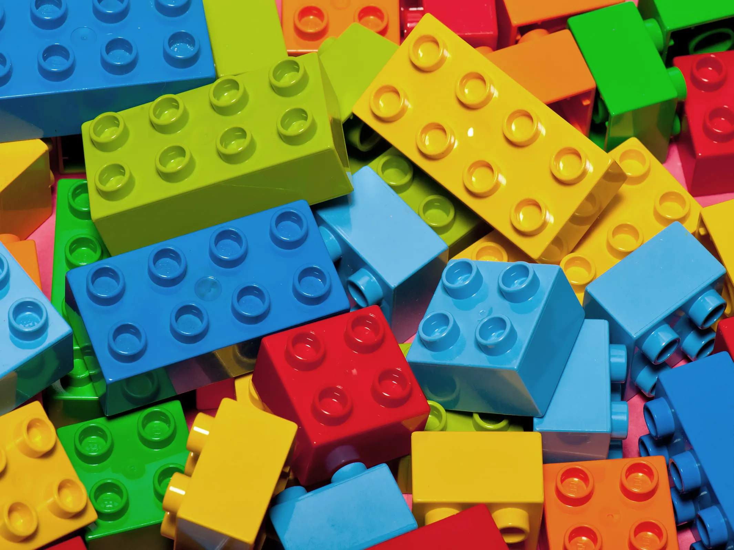
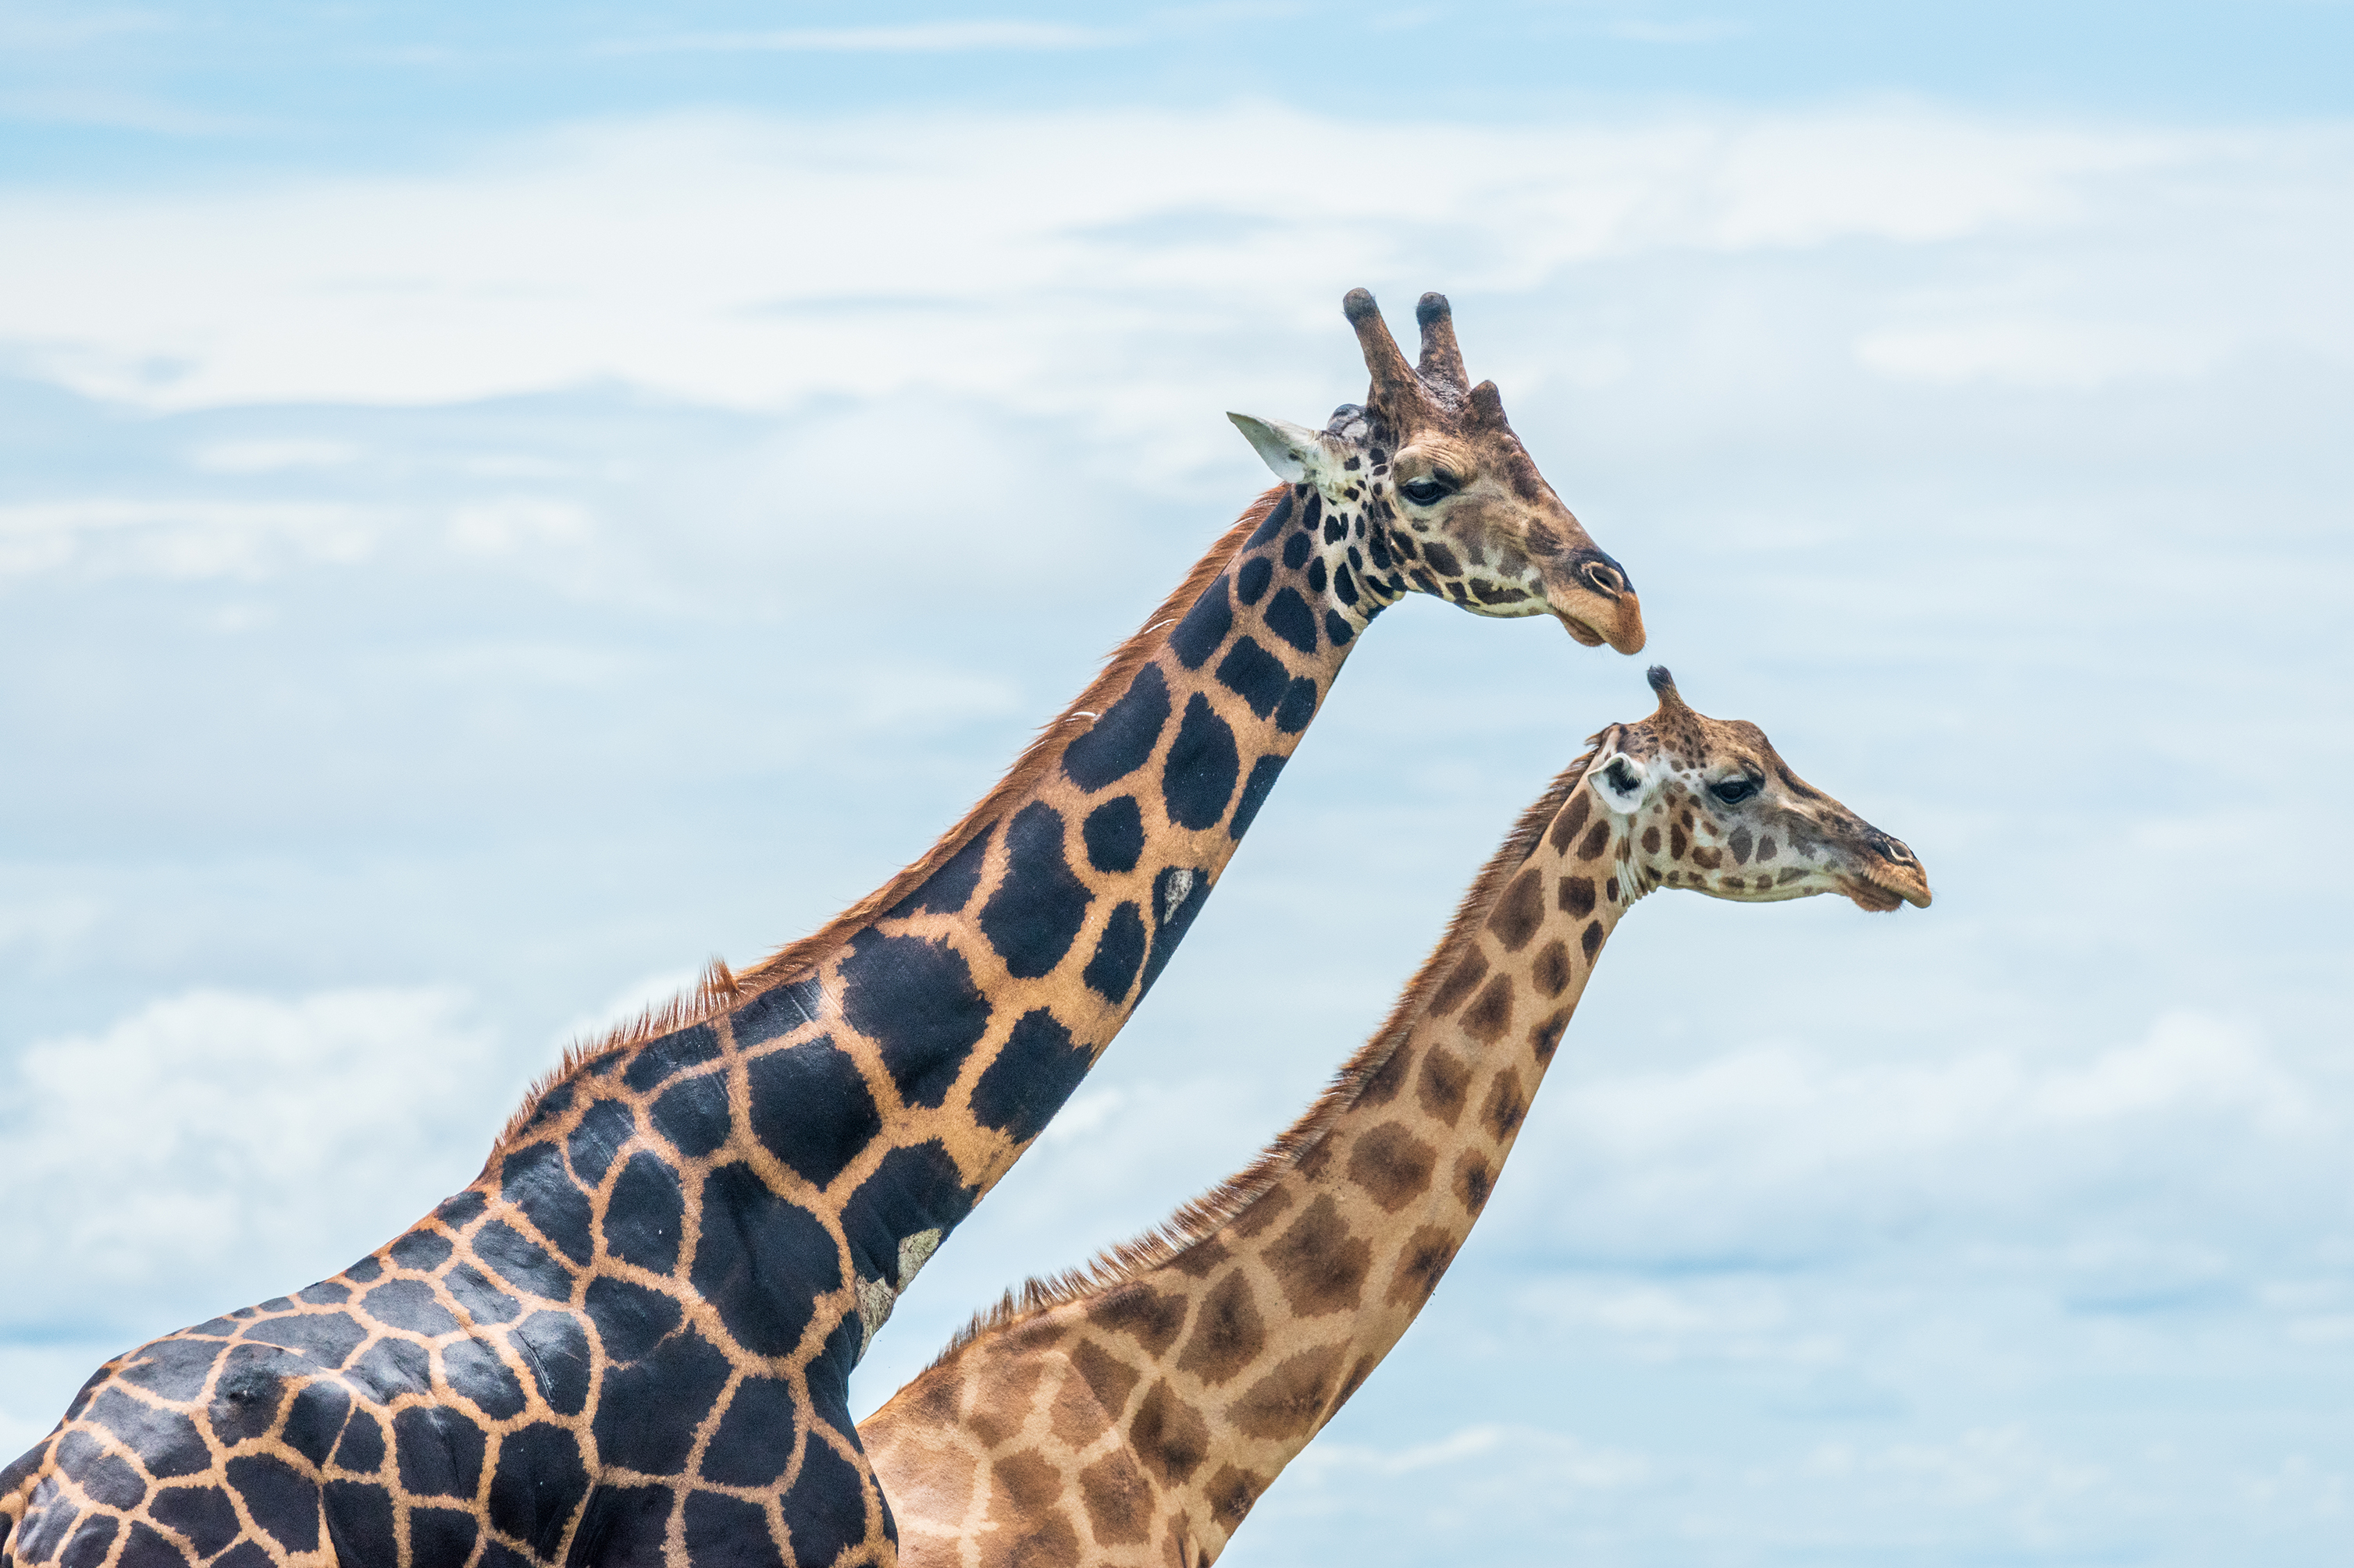
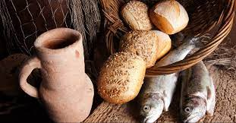
Awe

Slide 16
Acceptance
John 3 v 16

Slide 17
How can we have faith like little children?
Honesty
Trust
Awe
Acceptance

Slide 18
Faith Like Little Children

