Slide 1
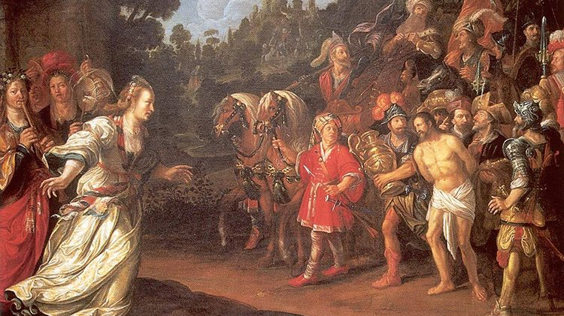
Adventure with God Means Change
Jephthah
Judges 10-12
Return of Jephthah – Jacob Waben - 1625

Slide 2
When?
c1070 BC
Return of Jephthah – Jacob Waben - 1625

Slide 3
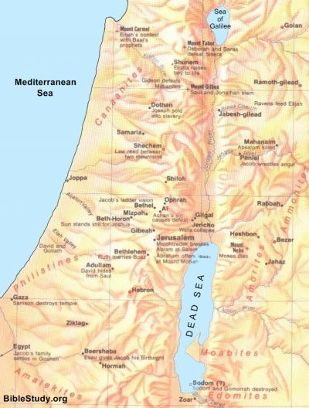
Who? Where?
Jephthah
MANASSEH
MANASSEH
From Gilead
GILEAD
RIVER JORDAN
Numbers 32, 35
GAD
REUBEN

Slide 4
Who? Where?
Gilead
MANASSEH
MANASSEH
Land is yours if…
GILEAD
RIVER JORDAN
…you win it
11:24
GAD
…statute of limitations
11:26
REUBEN

Slide 5
Who? Where?
Disputed Land
MANASSEH
MANASSEH
Judges 11:13
RIVER JABBOK
RIVER JORDAN
Judges 11:14-27
EPHRAIM
BENJAMIN
GAD
Exodus 20:14-21
AMMONITES`
Exodus 21:21-35
JUDAH
REUBEN
AROER
RIVER ARNON

Slide 6
Events Repeat Themselves…
Israel following idols
Conflict
See Gideon (Judges 6-8) and Abimelech (Judges 9)
Return of Jephthah – Jacob Waben - 1625

Slide 7
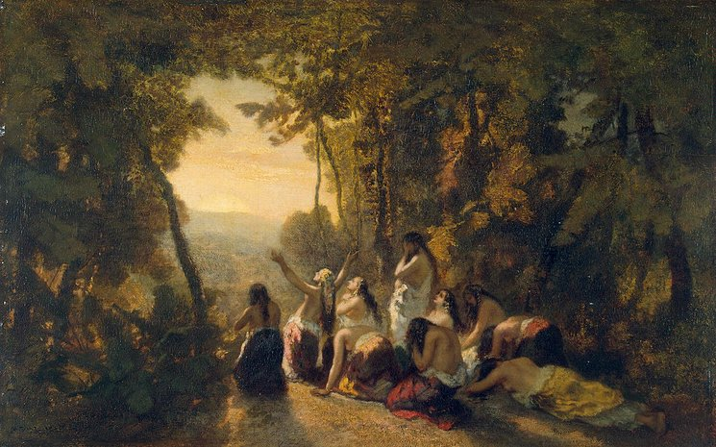
Change in Jephthah’s Life…
Son of unfaithful father
Accepted then rejected by family & society
Lived outside Israel as a bandit
9:4
Lament of Jephthah’s Daughter – Narcisse Diaz de la Pena - 1846

Slide 8
Who? Where?
Jephthah
MANASSEH
TOB
MANASSEH
From Gilead
GILEAD
RIVER JORDAN
Lived in Tob
GAD
REUBEN

Slide 9
Change in Jephthah’s Life…
Son of unfaithful father
Accepted then rejected by family & society
Lived outside Israel as a bandit
9:4
Lament of Jephthah’s Daughter – Narcisse Diaz de la Pena - 1846

Slide 10
Change in Jephthah’s Life…
Military commander
11:1, 29-33
…but violent
12:1-7
Negotiator
11:12-28
…but hard-headed
11:7-11
God-given opportunity to use gifts constructively
Lament of Jephthah’s Daughter – Narcisse Diaz de la Pena - 1846

Slide 11
Change in Jephthah’s Life…
…Typical of God
…Points to Jesus
Lament of Jephthah’s Daughter – Narcisse Diaz de la Pena - 1846

Slide 12
The Tragedy of Jephthah’s Daughter
…Promise wasn’t right – Not God’s plan
…God doesn’t approve of human sacrifice
Leviticus 18:21, 20:2
2 Chronicles 28:3, 33:6
Ezekiel 21:30, 23:37-39
Jeremiah 7:18, 19:5
Genesis 22?
Lament of Jephthah’s Daughter – Morgan Bible – c1250

Slide 13
Change For Israel…
10:10-16
From idols to God
Return of Jephthah – Jacob Waben - 1625

Slide 14
Change For Israel…
Idols…
Baal = Hadad = god of harvest/weather
Reshef = War
Astarte = goddess of love/war
Dagon = Corn
Asherah = goddess of fertility/sea
Chemosh
Molech = god of the underworld
etc.…
Shamash = sun
Return of Jephthah – Jacob Waben - 1625

Slide 15
Change For Israel…
…Complete redefinition of their worldview
Return of Jephthah – Jacob Waben - 1625

Slide 16
Change for Us…
…Complete redefinition of our worldview
…Trying to live this truth
…Become more like Jesus
…Our adventure of faith
Return of Jephthah – Jacob Waben - 1625

Slide 17
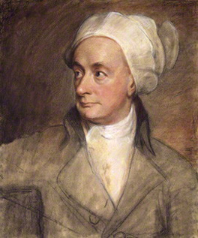
William Cowper
1731 - 1800

Slide 18
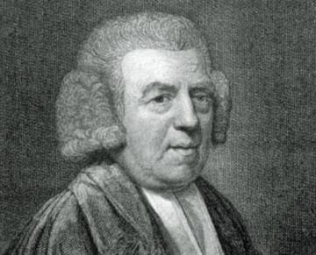
John Newton
1725 - 1807

