Slide 1
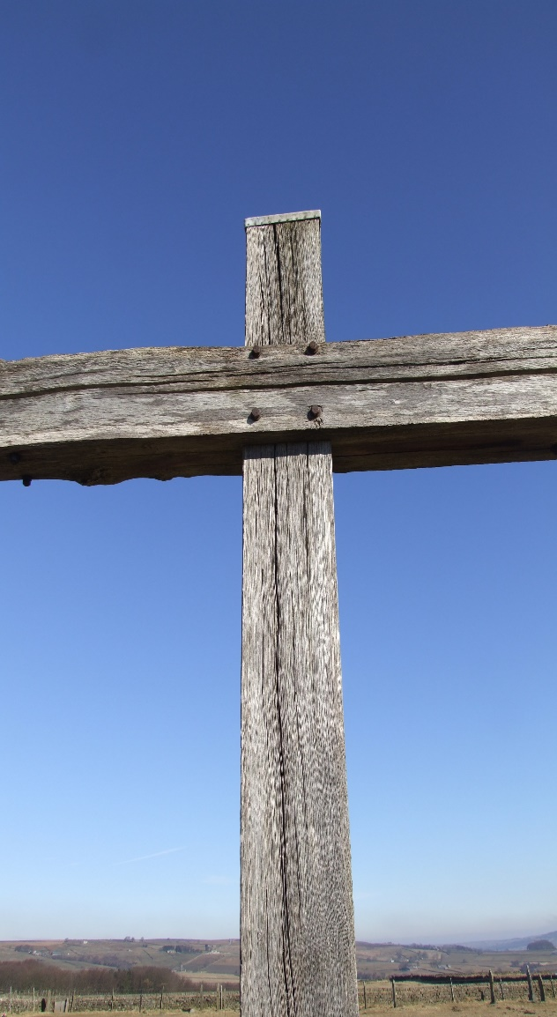
The uniqueness of Jesus
John 14 : 6
Acts 4 : 12

Slide 2
The uniqueness of Jesus
1. What Christians believe about Jesus
a) The person of Christ
Phil. 2 : 6 – 8a
John 1 : 14
b) The Work of Christ
Phil. 2 : 8 - 11

Slide 3
The uniqueness of Jesus
2. The centrality of the cross – Rom. 3 : 21 - 26
Human sin has separated us from God.
We are put right with God through faith, not through keeping “the law” etc.
Paul’s three illustrations :
Slave market – Rom. 3 : 24b
Sacrificial system – Rom. 3 : 25a
Law court – Rom. 3 : 25b – 26
1 Cor. 1 : 18 / 22 - 24

Slide 4
The uniqueness of Jesus
3. Big questions
Sincerity versus Truth
John 14 : 6
b) Justice versus Mercy
Rom. 9 : 14 – 16
c) Doing versus Done
Rom. 3 : 22 - 24

