Slide 1
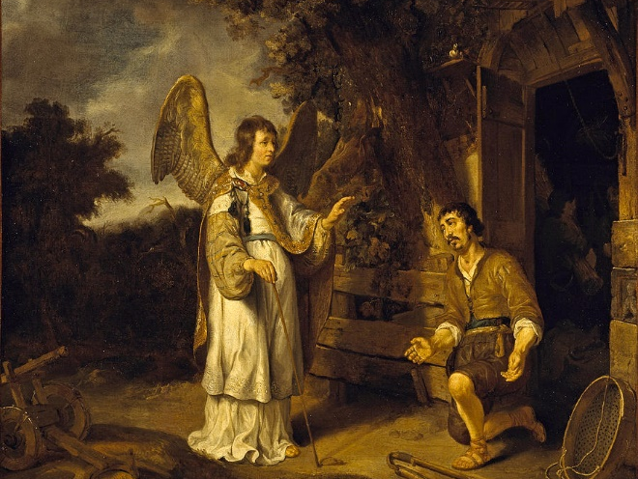
What is Trusting God Like?
Gideon
Judges 7
Angel of the LORD Meets Gideon - Gerbrand van den Eeckhout - C17th

Slide 2
How do you Currently Need to Trust God?

Slide 3
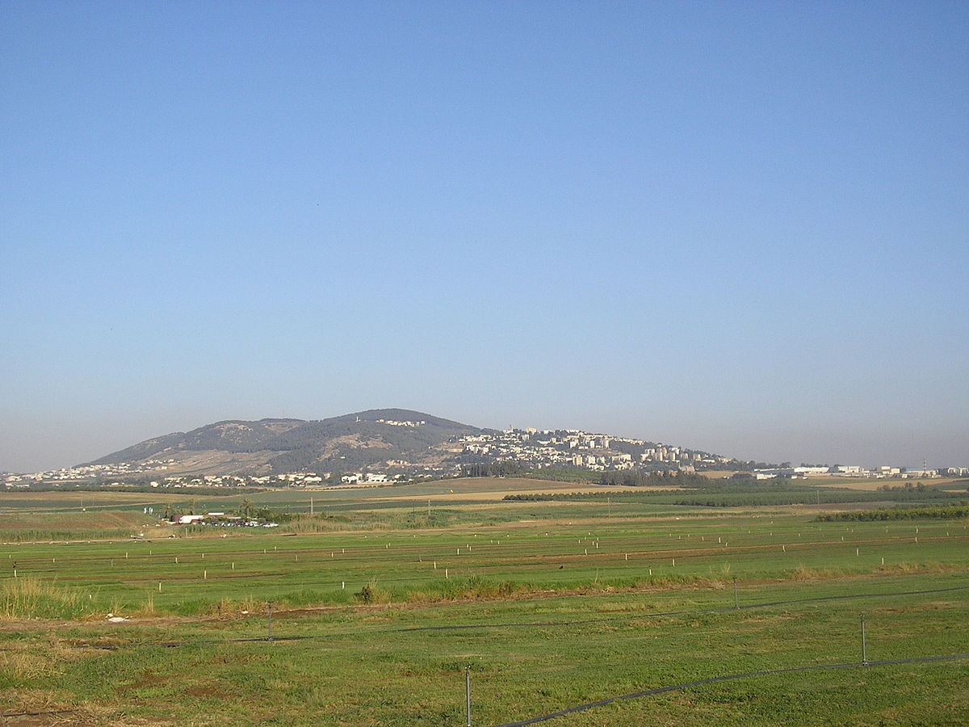
What Was Trusting God Like for Gideon?
Hill of Morah, Jezreel Valley

Slide 4
When?
~ 1100 BC
Hill of Morah, Jezreel Valley

Slide 5
Who?
Gideon
Hill of Morah, Jezreel Valley

Slide 6
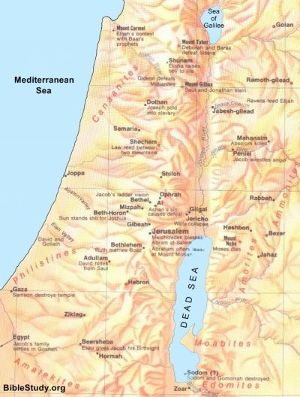
Who?
Gideon
MANASSEH
MANASSEH
RIVER JORDAN
OPHRAH?

Slide 7
Who?
Midianites
Nomadic
MANASSEH
MANASSEH
RIVER JORDAN
6:5
OPHRAH?
7:12
MIDIAN

Slide 8
Where?
MT. TABOR
Jezreel Valley
HILL OF MOREH
MANASSEH
MANASSEH
RIVER JORDAN
OPHRAH?
MIDIAN

Slide 9
Where?
Jezreel Valley
Hill of Morah, Jezreel Valley

Slide 10
What Can We Learn from War?
Old Testament
No international borders
Local Kings and Rulers
Decentralised Military
Judges 6:34-35, 7:23-24
Hill of Morah, Jezreel Valley

Slide 11
What Can We Learn from War?
Old Testament Rules of Engagement
Fight your equals in battle
8:18, 1 Sam 17:42-43
Family loyalty allowed greater retribution
8:19-20
Respect for enemies
8:18
8:22-23 9:50-55
Kings should have an honourable death
Battles rarely to the death
1 Sam 17:51-53
Plunder
8:1-3, Joshua 6:17-19, Joshua 8:2
God/god gives the victory
Joshua 6:15

Slide 12
What Happened?
Forfeit opportunity to a fair fight
300 Israelites circle the camp at night
…but the victorious act already happened
God revealed Himself to Midianites - Fear
Midianites fled
6:16 – God and Gideon do it together
Hill of Morah, Jezreel Valley

Slide 13
God Invited Gideon to Trust Him
Humbly Acknowledge and Accept Vulnerability
Acknowledge and Accept God’s Power and Love
Act in Obedience to God – Re-evaluate Situation
Hill of Morah, Jezreel Valley

Slide 14
Jesus Invites Us to Trust Him
Humbly Acknowledge and Accept Vulnerability
Acknowledge and Accept God’s Power and Love
Act in Obedience to God – Re-evaluate Situation
Hill of Morah, Jezreel Valley

Slide 15
What is Trusting God Like?
Humbly Acknowledge and Accept Vulnerability
Acknowledge and Accept God’s Power and Love
Act in Obedience to God – Re-evaluate Situation
Hill of Morah, Jezreel Valley

Slide 16
Trusting God Can Be Like…
Canaanite Woman – Matthew 15
Generous Widow – Luke 21
Father with Ill Son – Mark 9
Paul and Silas in Prison – Acts 16
Going the Extra Mile – Matthew 5
Jesus in Gethsemane – Luke 22
Jesus Clearing the Temple – Mark 11
Hill of Morah, Jezreel Valley

Slide 17
Trusting God Can Be Like…
Paul’s Thorn – 2 Corinthians 12
Considering the Birds – Mark 6
Hill of Morah, Jezreel Valley

Slide 18
Trusting God in Our Situation…
What weakness/uncertainty/risk?
How to acknowledge God love and power?
What is a trusting, obedient response?
How do you need God’s help with that?
Hill of Morah, Jezreel Valley

