Slide 1
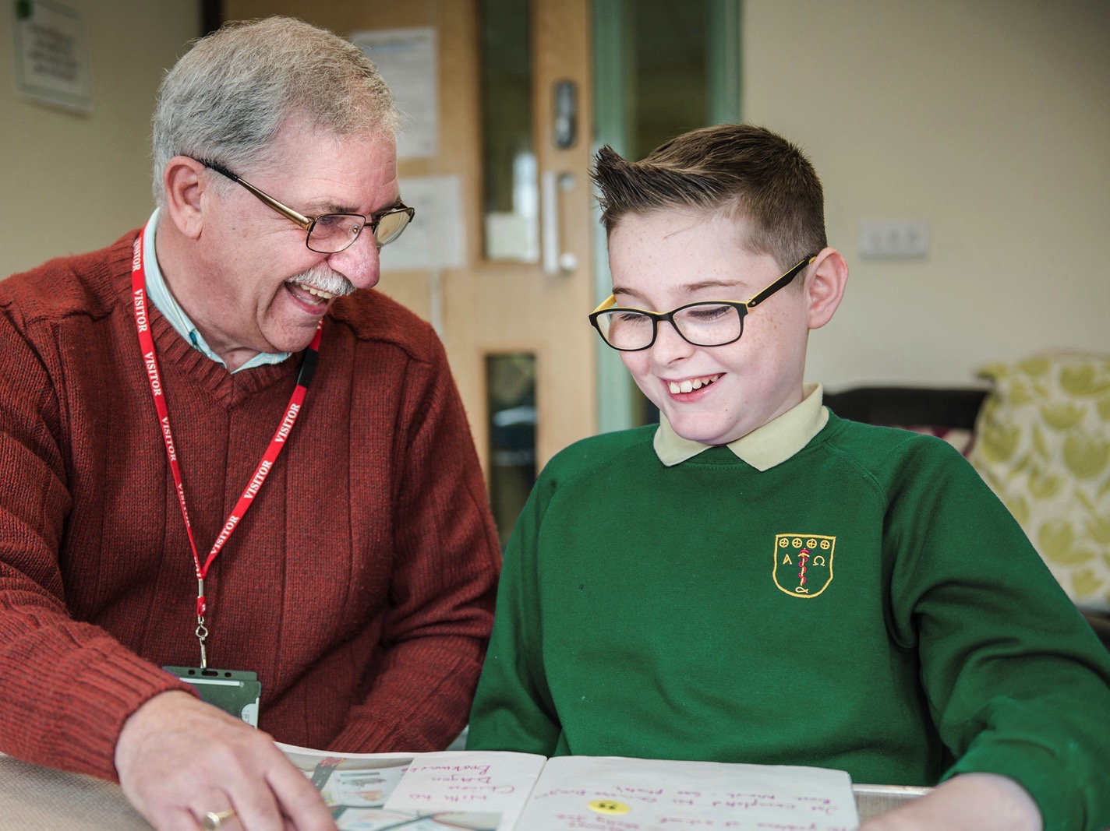
tlg.org.uk
Transforming
Lives for Good

Slide 2
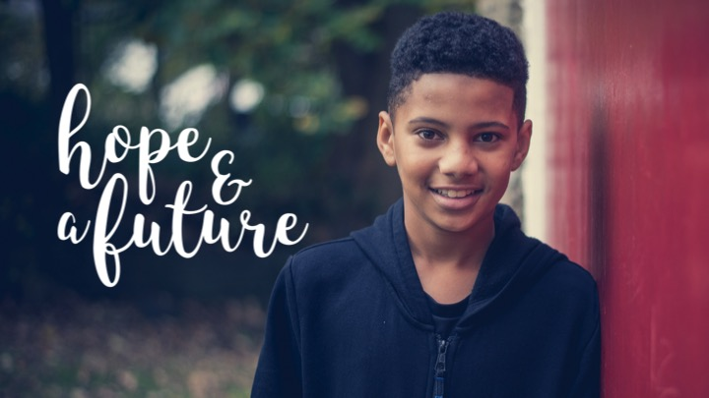

Slide 6
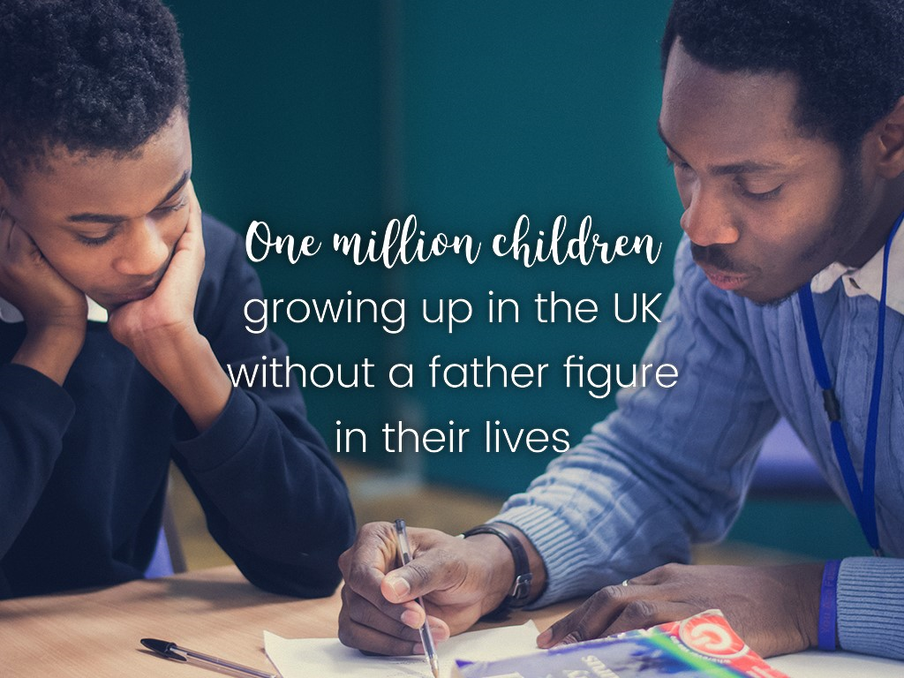

Slide 8
Transforming
Lives for Good

Slide 10
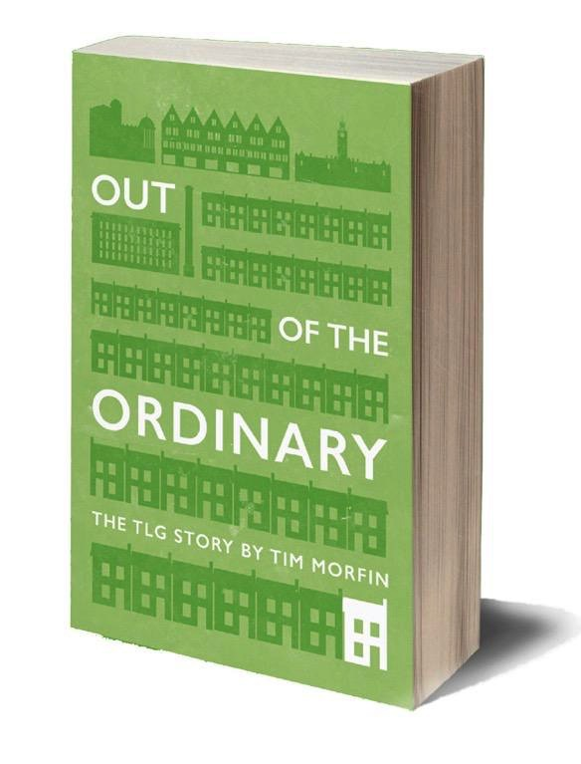
Keeping in touch
Notes:
sign up to keep in touch with the vision, receive our prayer letters, and hear exciting stories of transformation.
WE have a free book to give you, by founder Tim Morfin,who founded the charity nearly 20 years ago.
And of course we’re always delighted to meet people who might want to support through making a donation, either a one-off or regular. See me afterwards if you feel prompted to support in that way.

