Slide 1
Colossians 1: 15 - 23
Jesus: “The image of the invisible God.”
Jesus is Divine
Jesus was Human

Slide 2
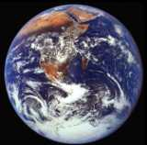
Jesus: The Lord of Creation - vv. 15 - 17
The Source of Creation - v.16
The Goal of Creation - v. 16c
The Sustainer of Creation - v. 17

Slide 3
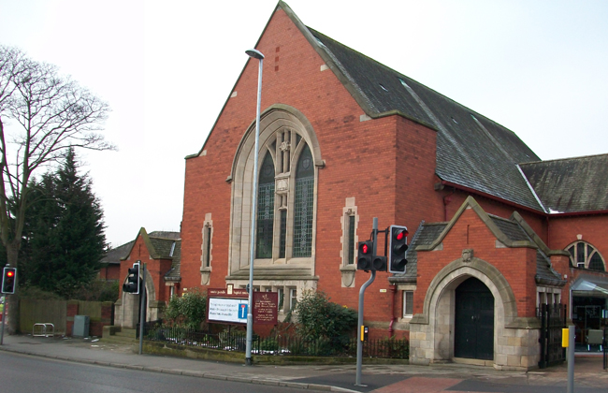
Jesus: The Lord of the Church - vv.18 - 20
The Source of the Church’s Life – v.18b
The Goal of the Church’s Life - v.18c
The Sustainer of the Church’s Life - v.18a

Slide 4
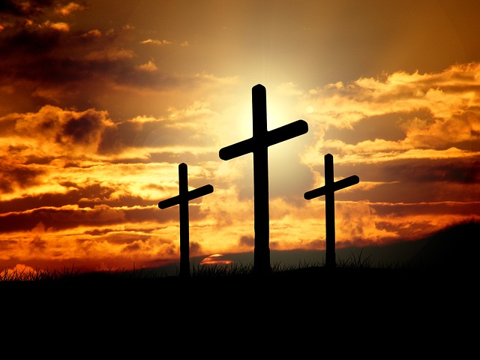
Jesus: The Lord of Salvation - vv. 21-23
“Peace through his blood
shed on the cross”
The “alienated” become “holy”
“Enemies” become “without blemish”
“Evildoers” become “free from accusation”.

Slide 5
Jesus: “The image of the invisible God”
The Lord of Creation.
The Lord of the Church.
The Lord of Salvation.
“This is the Gospel that you heard and that has been proclaimed to every creature under heaven and of which I ,Paul, have become a servant.”

