Slide 1
south parade together discipleship: John 13 and 21 when restoration is needed
Notes:
Tate modern
Long handled mop and bucket

Slide 2
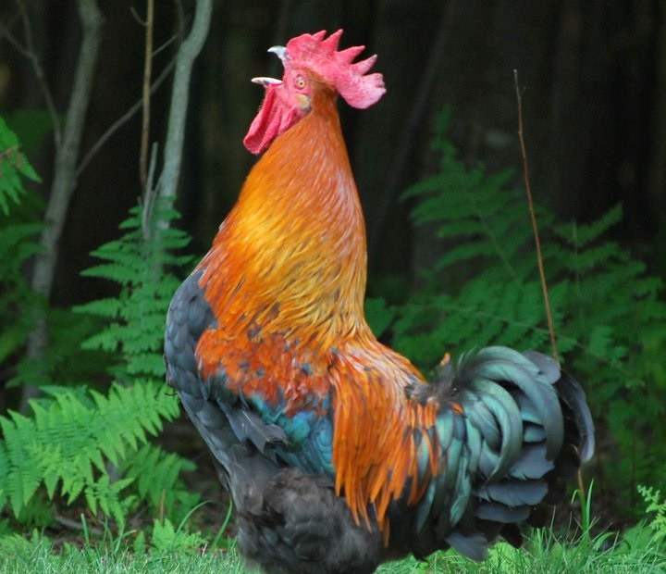
1. When a disciple falls
John 13.32
‘I will lay down my life for you’
Self-confidence rather than God-confidence leads to a fall
Notes:
I will lay down my life for you – no Peter, Jesus will lay his life down for you. Self-confidence rather than God-confidence leads to a fall.
Photo of those I trained with. 4 marriages collapsed out of eighteen. Those who think they stand should be careful in case they fall.
But sin – going our own way rather than God’s way – messes up our relationship with God, messes up our lives, messes up the lives of other people. Sin seems to promise much but it delivers bitterness and heartache.
Thomas Watson – a holy hatred of sin; Jeremiah Burroughs, the exceeding sinfulness of sin. Not because we’re censorious and ‘holier than thou’, not because we look down our noses at people. Because we’re aware of the damage it causes.
The illustration of David. Adultery, compounded with murder. Is he forgiven, absolutely (Psalm 51). Are their consequences? Yes. The story of Absalom, David’s son.
The worst thing we can say is, that will never happen to me. Trust in God, not ourselves.

Slide 3
2. When a disciple is restored
John 21.15-19
Isaiah 42.3 ‘a bruised reed he will not break’
Notes:
John 18 shows us Peter’s threefold denial.
All the disciples fled,. None of them understood about the cross. They all got it wrong. Will Jesus start again? We would think so, but we reckon without the extraordinary grace of God.
Jesus dies in God-forsaken loneliness, dying in our place to win us forgiveness.
In John 21, Peter is here. Jesus is still dealing with him. v
Again we can illustrate from the OT
A bruised reed he will not break, a smouldering wick he will not snuff out.
The burden of this message is to apply this point. Whatever you’ve done, however you’ve fallen, there is grace for you.

Slide 4
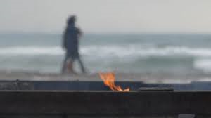
3. The path to restoration
John 21.15-22: Do you love me?
Notes:
Points to make…
v15 Do you truly love me more than these?
More than these others love me…
Do you love me more than you love these others? For sure we need to love Jesus first and foremost.
But more likely Peter is being invited to make a comparison. Do you love me more than these others love me? Will Peter retain his breezy self confidence? No – you know that I love you.
A confidence in God, but no comparison.

Slide 5
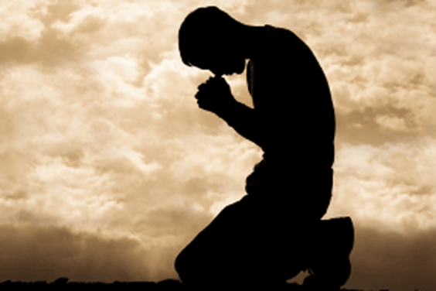
4. The call comes again – follow me
Restoration to fellowship and restoration to service
Notes:
Agape and phileo (gracious love of God contrasted with brotherly love). Sometimes speakers make much of this. But the switch here is stylistic.
What does happen is a leading through: Threefold denial and threefold restoration. Not only restoration to fellowship but to service.
Apply strongly. Catastrophic fall. A slow descent and coldness.
vv18 the call to cross bearing and radical discipleship. Radical grace and radical discipleship
Broken vase illustration
For those who are broken there is restoration, forgiveness, great and amazing grace. God calls us to turn from sin and shame,

Slide 6
5. encouragement
God loves you, wants to forgive, wants to use you again…

