Slide 1
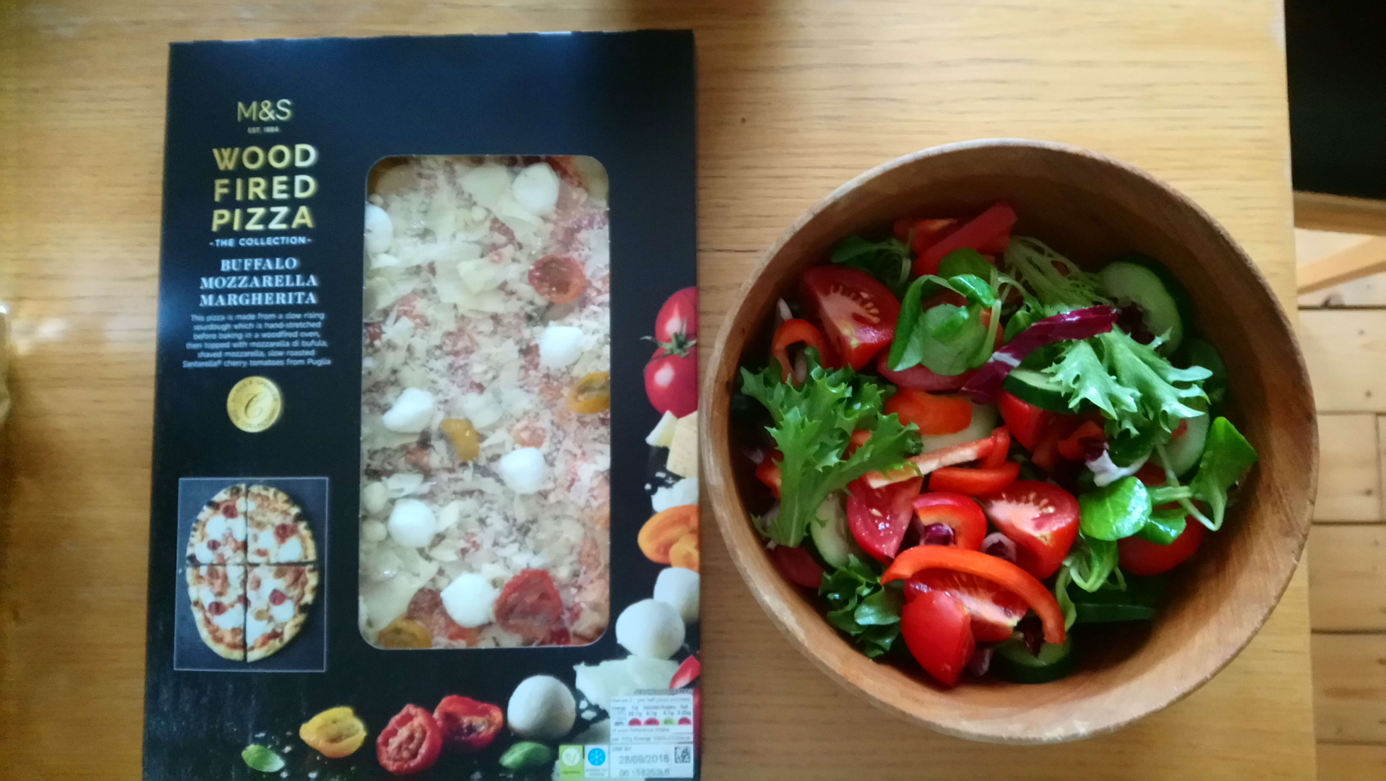
Living God’s Way
Hospitality: Hebrews 13.1-3; 1 Peter 4.7-11

Slide 3
1. God Shows us Amazing Hospitality….
Hebrews 13.1 ‘Brothers…’

Slide 5
1. … So we should show hospitality to others
i. How?
We are called to do this well
1 Pet 4.8. ‘Offer hospitality…without grumbling’

Slide 6
God’s building project for South Parade…

Slide 7
ii. When?
Communion
Student lunches, Rooted, Welcome,
Small groups,
Sharing meals

