Slide 1
Seeking Growth in God’s Love
Philippians 3:7-14

Slide 2
Seeking Growth
Using Disciplines
Engaging Mission
Sharing Fellowship

Slide 3
Are you hungry for more of God?

Slide 4
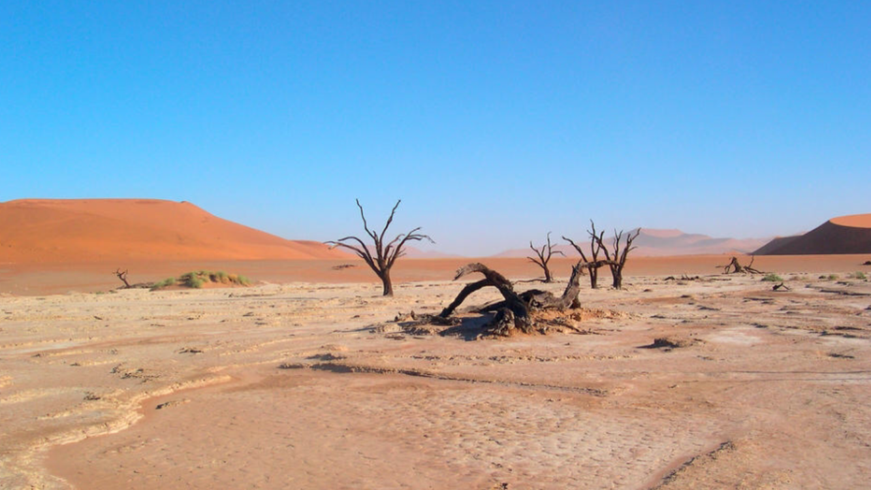
Seeking Growth in God’s Love
Psalm 63:1-5

Slide 5
In the last 2 weeks, where have I seen God in my daily life?

Slide 6
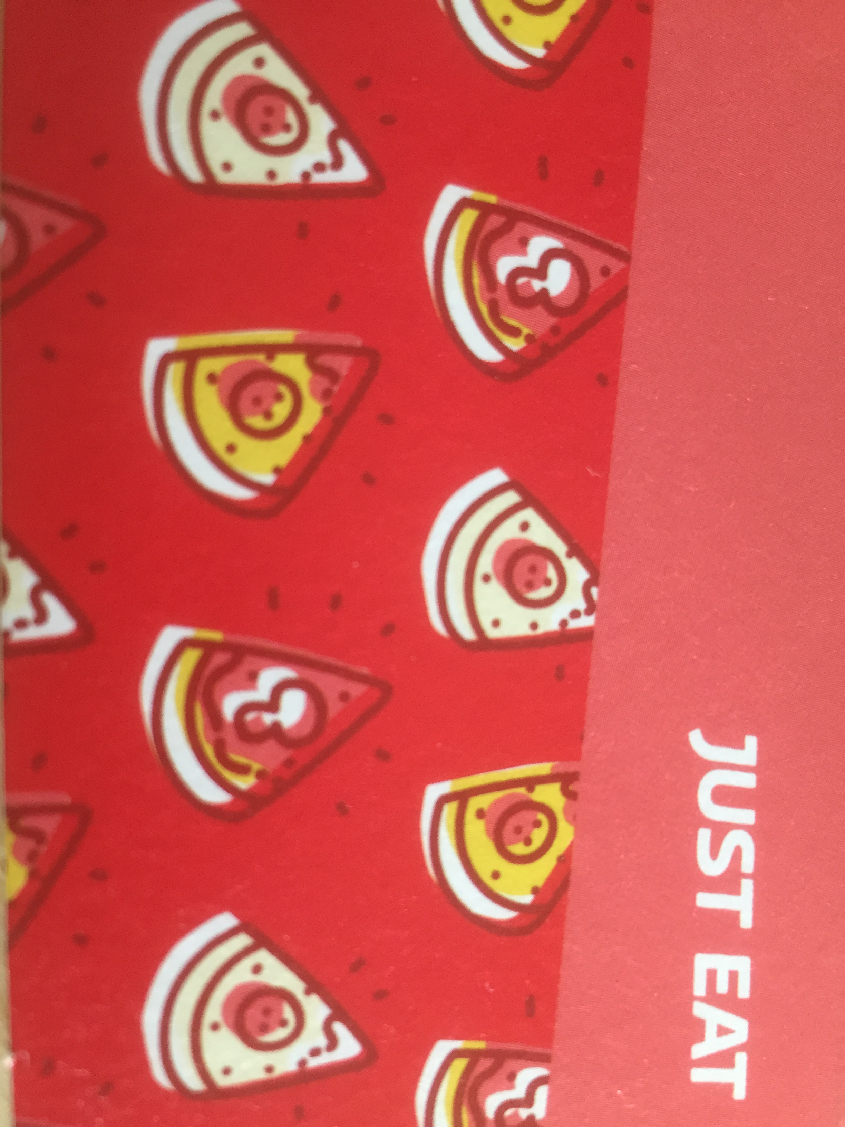
If you could eat anything you like right now, what would it be? Get ready to just call out answers.

Slide 7
How is hunger for God expressed at Cornerstone Baptist Church?

Slide 8
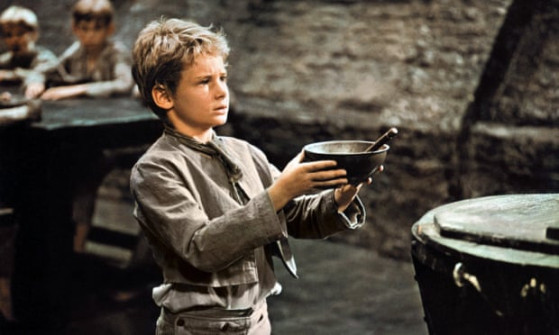
MORE?!

Slide 9
What or who helps me long for more of God?
What or who pulls me away from Jesus and quenches the Spirit?
Why not resolve to seek growth
this week? Sign up for 28th March!

